Slide 1
Account Opening System (H5) Tutorial 华泰金融美国公司手机开户系统培训
Huatai Financial USA Inc| 201805
声明：期货交易风险较高，不适合所有投资者。请评估交易是否适合您。本文信息仅供参考，不应理解为华泰金融美国公司征求购买或出售任何期货合约的行为。
DISCLAIMER: FUTURES TRADING ENTAILS SIGNIFICANT RISK OF LOSS WHICH SHOULD BE UNDERSTOOD PRIOR TO TRADING AND MAY NOT BE SUITABLE FOR ALL INVESTORS. PLEASE CONSIDER WHETHER TRADING IS SUITABLE FOR YOU. THIS IS NOT A SOLICITATION TO BUY OR SELL FUTURES PRODUCTS BY HUATAI FINANCIAL USA INC.
© 2018 Huatai Financial USA, INC.
Notes:
大家好，欢迎收看华泰美国思迪开户系统教学视频

Slide 2
关于华泰金融美国公司
About Huatai Financial USA Inc.
Founded in 2015 and based in Chicago, Huatai Financial USA Inc. (Huatai USA) is registered as a Futures Commission Merchant (FCM) with the Commodity Futures Trading Commission (CFTC) and a member of the National Futures Association (NFA). As a member of Huatai group, Huatai USA is approved by the Chinese Securities Regulatory Commission (CSRC). Huatai USA emphasizes on introducing qualified Chinese investors to international market and introducing international investors to Chinese market.
华泰金融美国公司(华泰美国)成立于2015年，总部位于美国芝加哥，是美国商品期货交易委员会（CFTC）的注册期货经纪商（FCM）和美国期货协会（NFA）的会员。作为华泰集团的一员，华泰美国获得了中国证券监督管理委员会（CSRC）的批准。华泰美国致力于将中国合格投资者引入国际市场，并协助国际投资者进入中国市场。
© 2018 Huatai Financial USA, INC.

Slide 3
Table of Contents 目录
Account Registration 注册账户-------------------------------------------------------------------------------------P4
Step 1 – Choose the Referrer 选择营业部-----------------------------------------------------------------------P6
Step 2 – Choose the Account Type 选择账户类型-------------------------------------------------------------P7
Step 3 – Fill in the Information 填写信息------------------------------------------------------------------------P8
Individual 个人-------------------------------------------------------------------------------------------------------P9
Joint 联名-------------------------------------------------------------------------------------------------------------P19
Sole Proprietorship 独资公司-----------------------------------------------------------------------------------P24
Corporate 公司------------------------------------------------------------------------------------------------------P26
Partnership 合伙制-------------------------------------------------------------------------------------------------P36
Limited Liability Company 有限责任公司--------------------------------------------------------------------P39
Step 4 – Upload the Credentials and Document 上传证件资料-------------------------------------------P41
Step 5 – Sign Agreement 签署协议-------------------------------------------------------------------------------P42
Step 6 – Preview Application 申请预览--------------------------------------------------------------------------P43
Step 7 – Complete Application 申请成功------------------------------------------------------------------------P43
© 2018 Huatai Financial USA, INC.

Slide 4
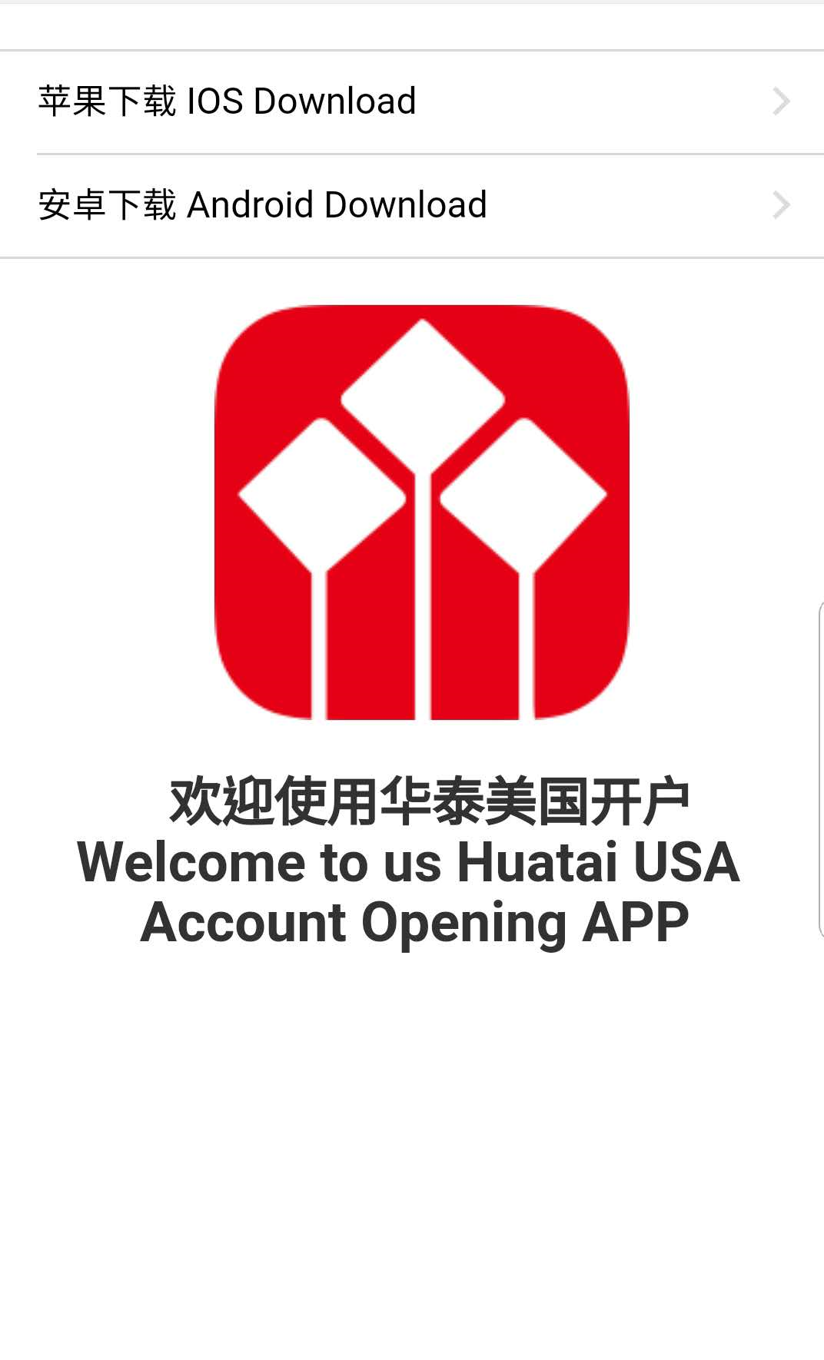
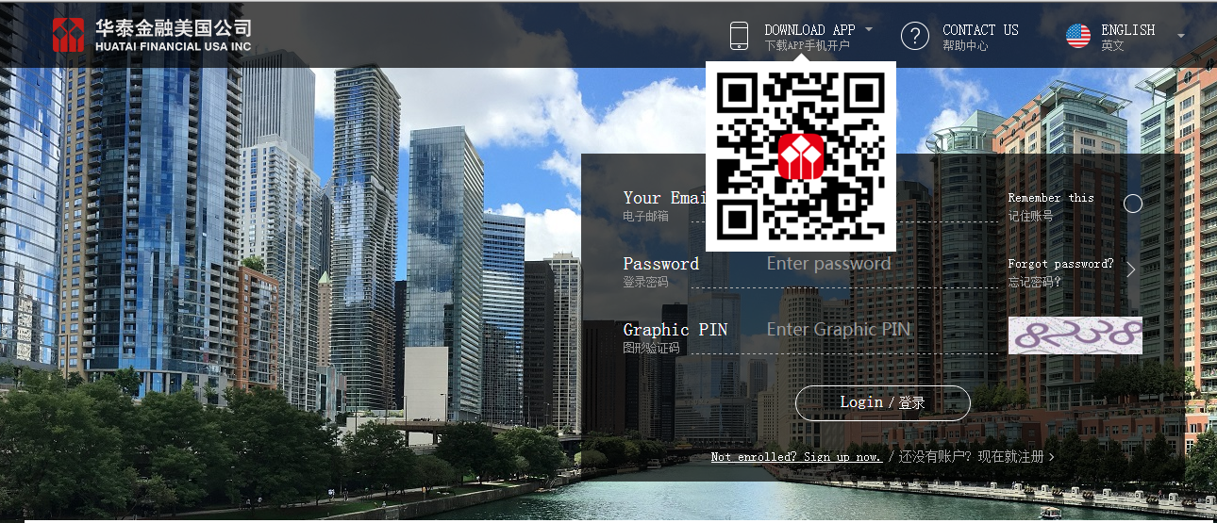
下载链接 link: https://openaccount.huataiusa.com
打开网页后需要扫描二维码下载手机开户软件
Scan the QR code to download the account opening app.
© 2018 Huatai Financial USA, INC.
Notes:
首先，我们来看一下个人帐户开户

Slide 5
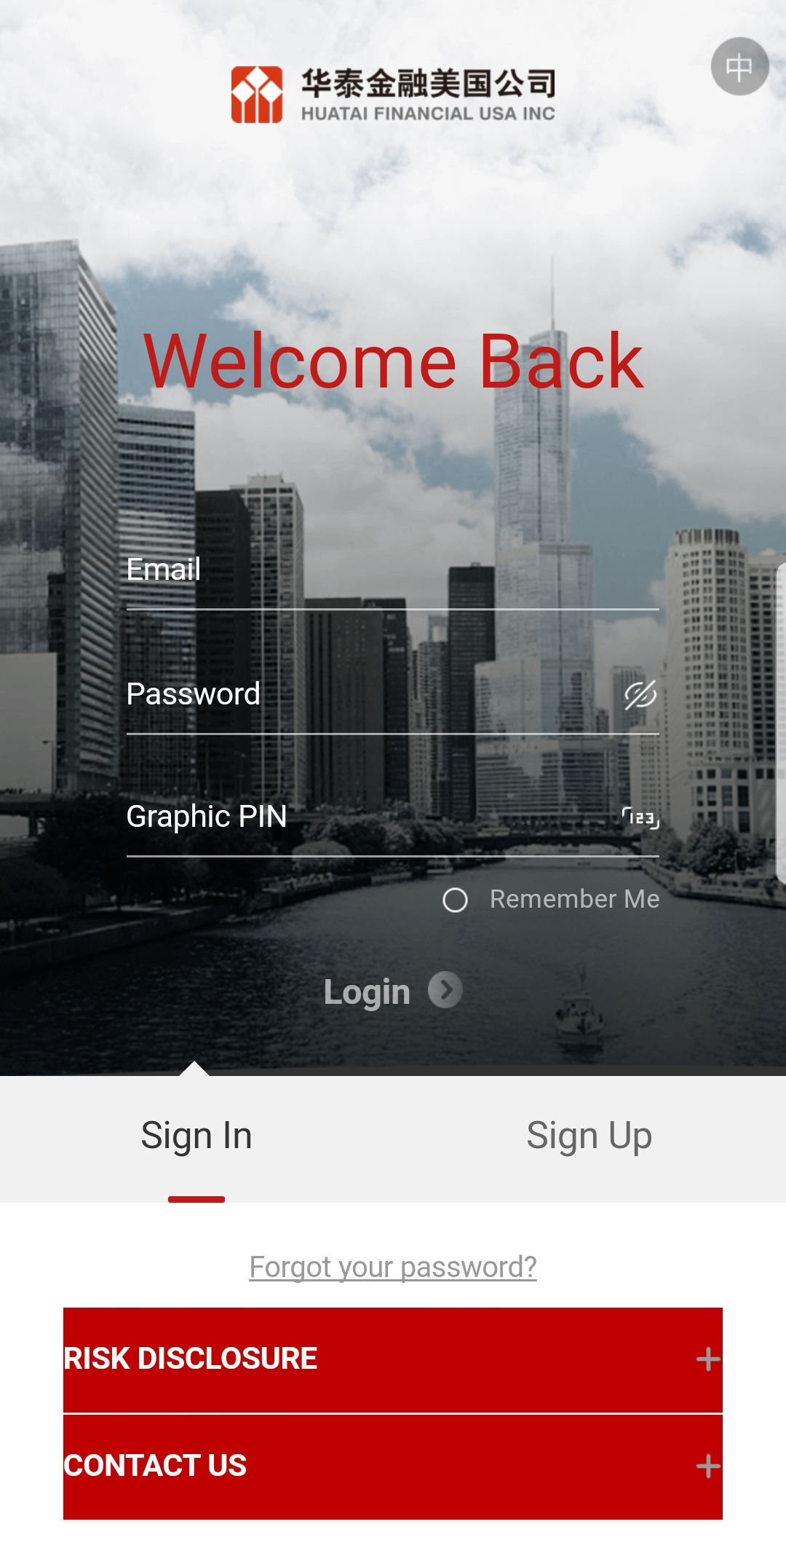
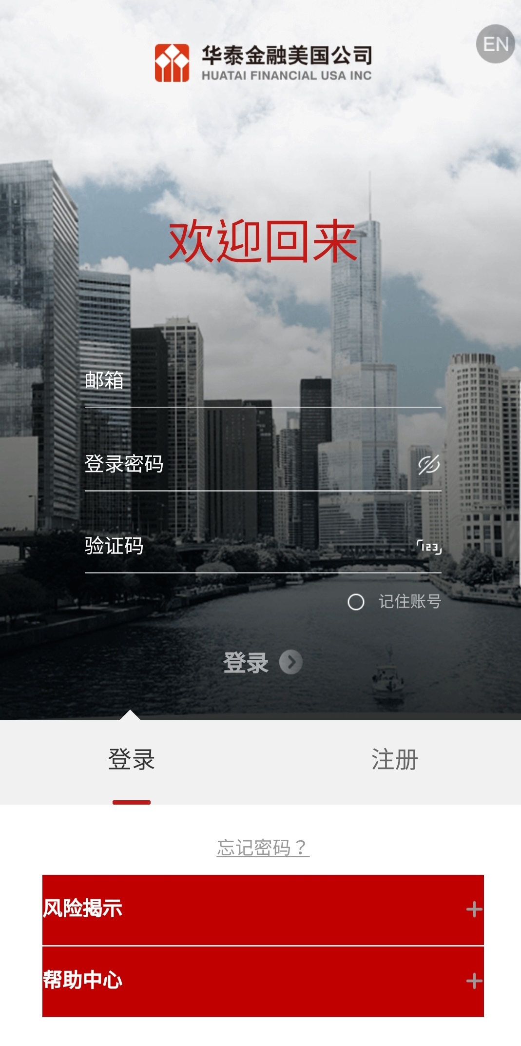
1 选择语言
Select the language
2 注册 Sign up
开户前需先用电子邮箱在该开户网站注册一个账户，以供后续的开户信息填写。
Firstly, you need to register an account in this account opening system.
3 登陆 Sign in
*该注册账户是开户系统登入账户，非期货交易账户。该账户与网页版的登入一致
*This account is not for trading. The account is able to access both App and website.
© 2018 Huatai Financial USA, INC.
Notes:
首先，我们来看一下个人帐户开户

Slide 6
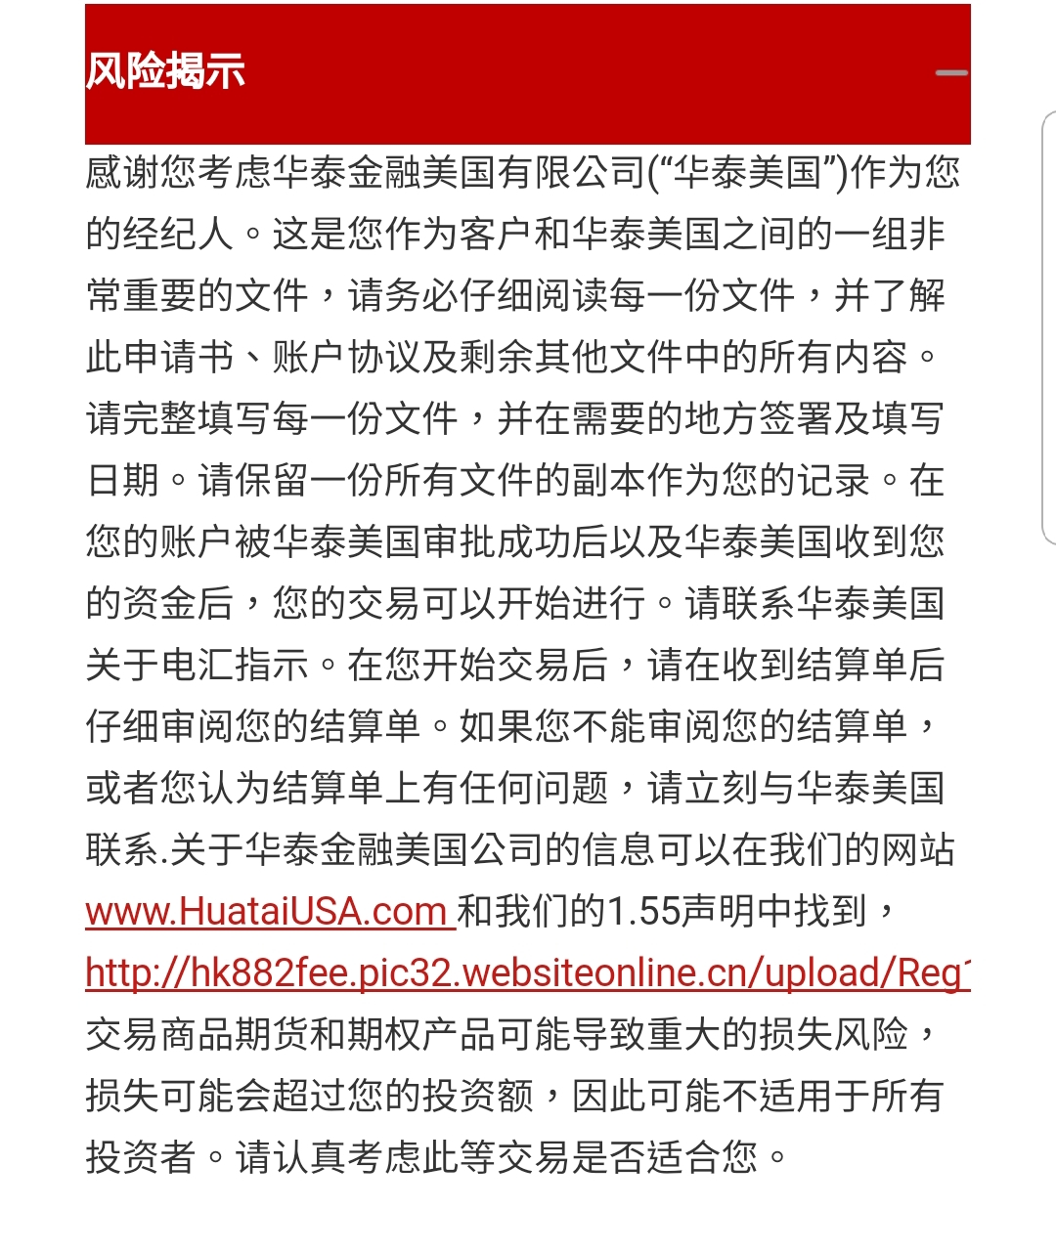
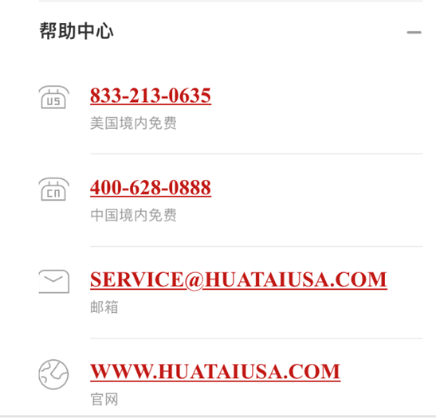
开户前请仔细阅读风险揭露，认真考虑是否适合进行交易。
如有任何疑问，可随时与我们联系。
Please read the Risk Disclosure carefully and consider whether the trading is suitable for you.
If there is any question, please feel free to contact Huatai USA.
© 2018 Huatai Financial USA, INC.
Notes:
首先，我们来看一下个人帐户开户

Slide 7
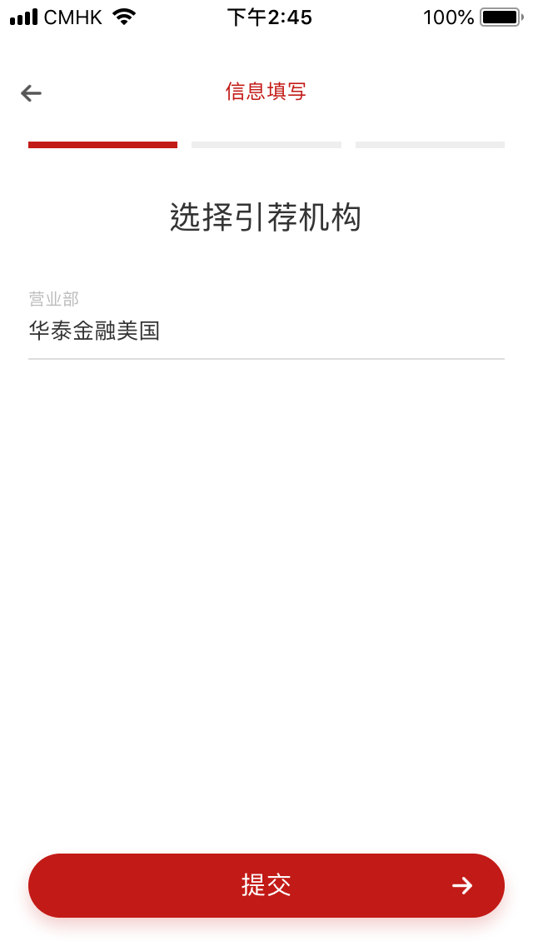
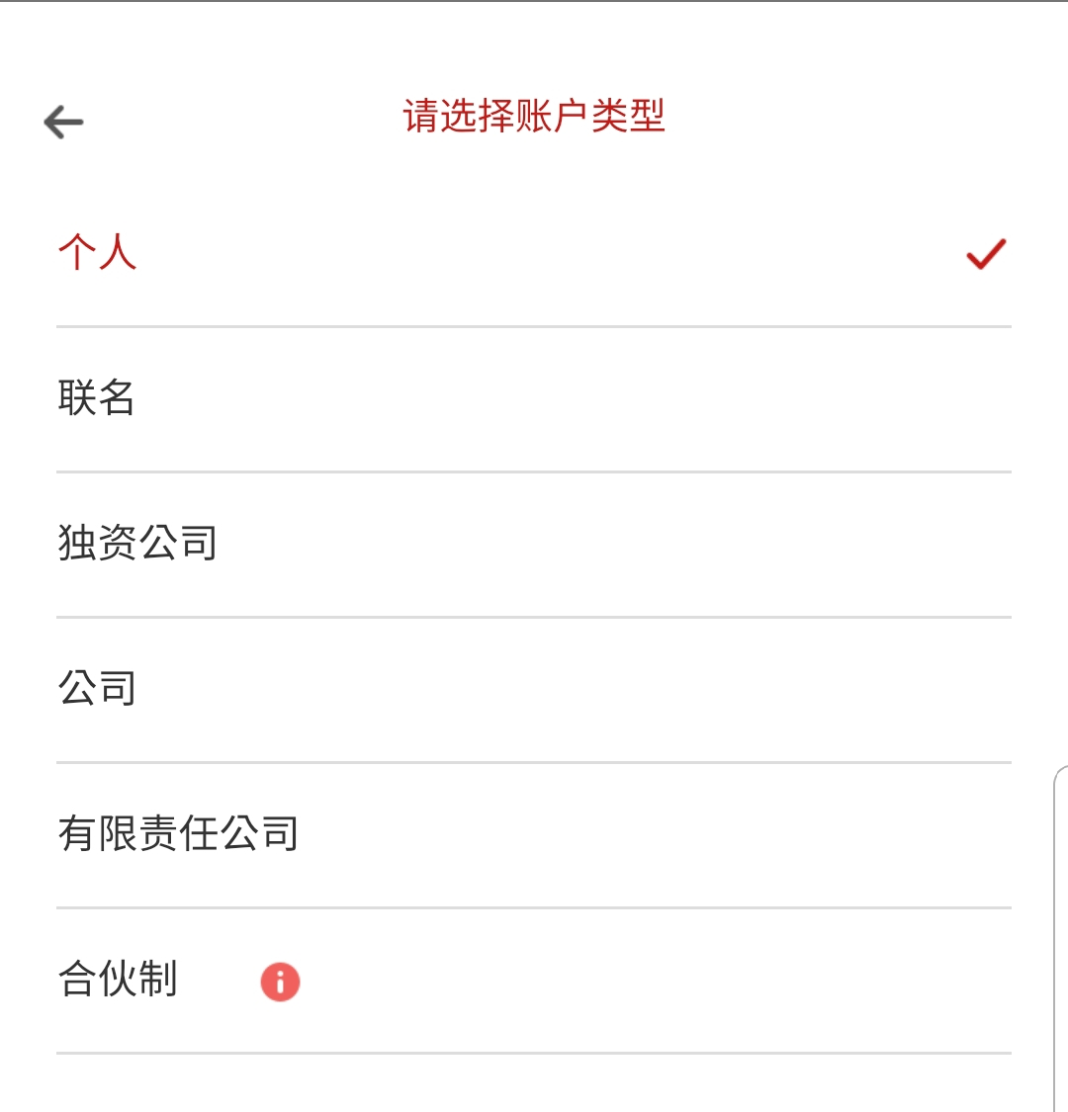
Step1 Select the referrer and account type
步骤1 选择账号类型与引荐机构
Choose the account type
选择账户类型
Choose the referrer. It is defaulted as
Huatai USA.
选择引荐机构,系统默认为”华泰金融美国”。
© 2018 Huatai Financial USA, INC.
Notes:
首先，我们来看一下个人帐户开户

Slide 8
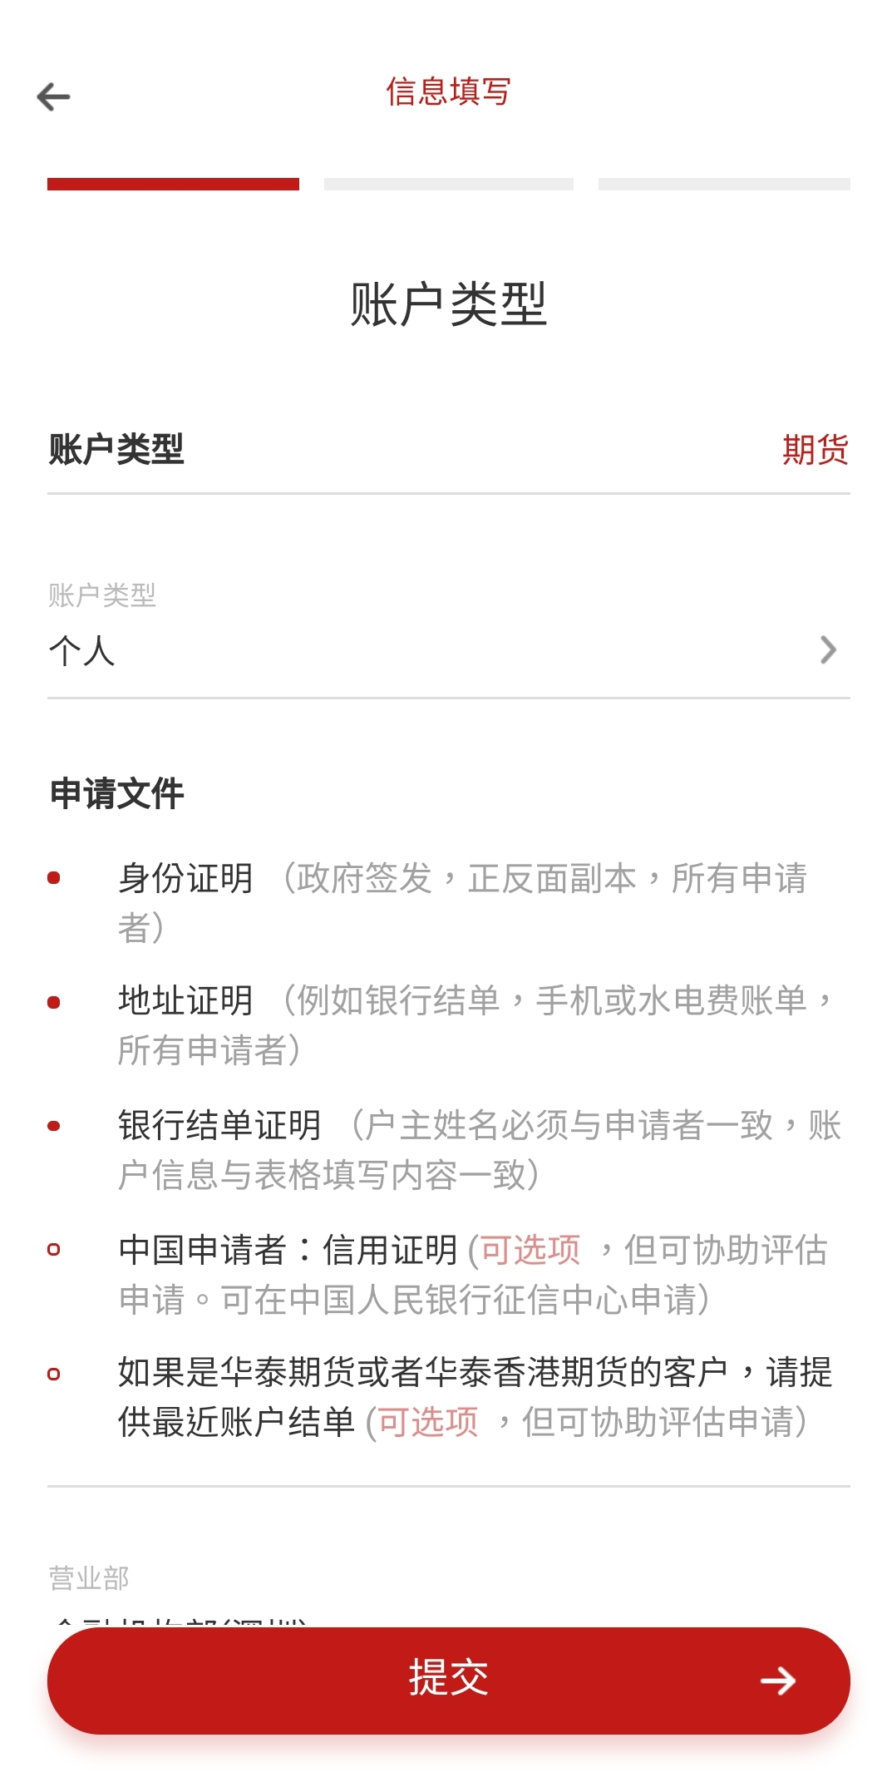
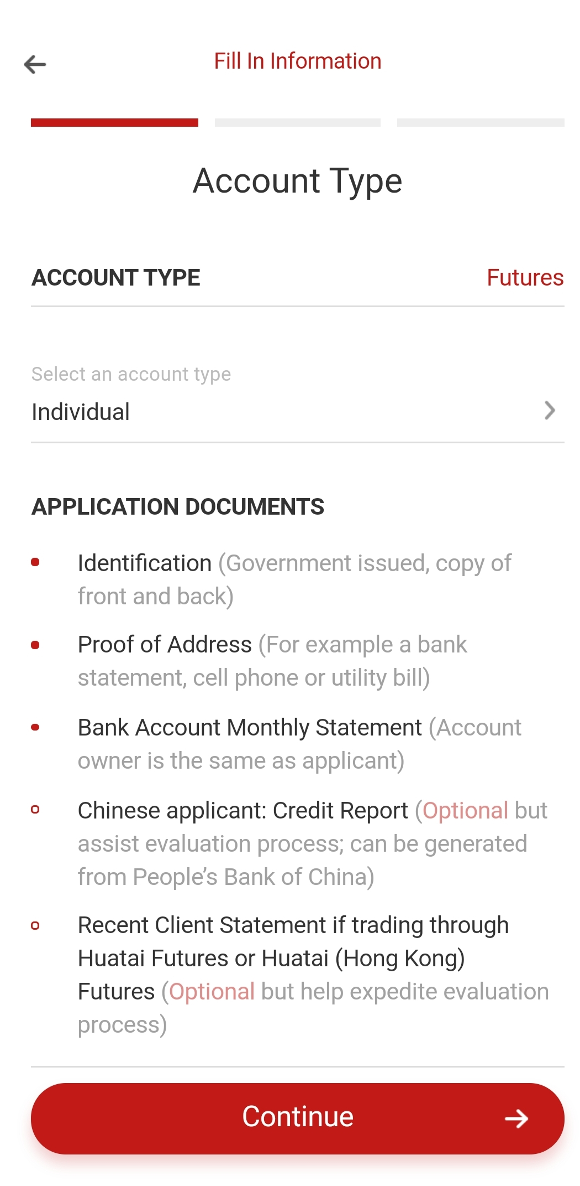
Step1 Select the referrer and account type
步骤1 选择账号类型与引荐机构
Additional Application Documents:
List the documents needed for the application. Please note that if you choose a different account type, the list will change. Please prepare the needed documents based on the actual account type.
其他补充文件：
提示您在开户过程中所需要的文件。请注意，当您选择不同的账户类型时，补充文件会有变化，因此请您务必根据您的账户类型准备相应的补充文件。
© 2018 Huatai Financial USA, INC.
Notes:
首先，我们来看一下个人帐户开户

Slide 9
Step 2 Fill in the Information
第二步 填写信息
Individual 个人------------------------------------------------------------------------------------------------------P9
Joint 联名-------------------------------------------------------------------------------------------------------------P24
Sole Proprietorship 独资公司------------------------------------------------------------------------------------P27
Corporate 公司------------------------------------------------------------------------------------------------------P30
Limited Liability Company 有限责任公司--------------------------------------------------------------------P41
Partnership 合伙制-------------------------------------------------------------------------------------------------P43
This step would be slightly different when choosing different account types. For your convenience, we will present the following contents based on different account types. Since Individual and Corporate account types are the most typical ones, they will be discussed in great details.
对于不同类型的账户，此步骤的填写内容及要求会有一些小区别。为了您的方便，接下来将按照不同账户类型为您介绍此步骤的填写流程。其中，个人／公司类型最具代表性，会进行详细介绍，其它账户类型请参考此二类。

Slide 10
个人帐户 Individual
© 2018 Huatai Financial USA, INC.
Notes:
首先，我们来看一下个人帐户开户

Slide 11
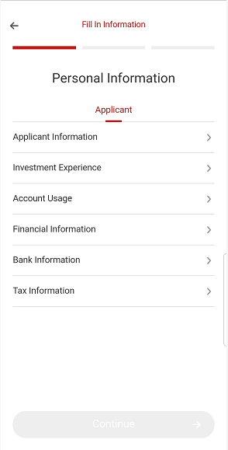
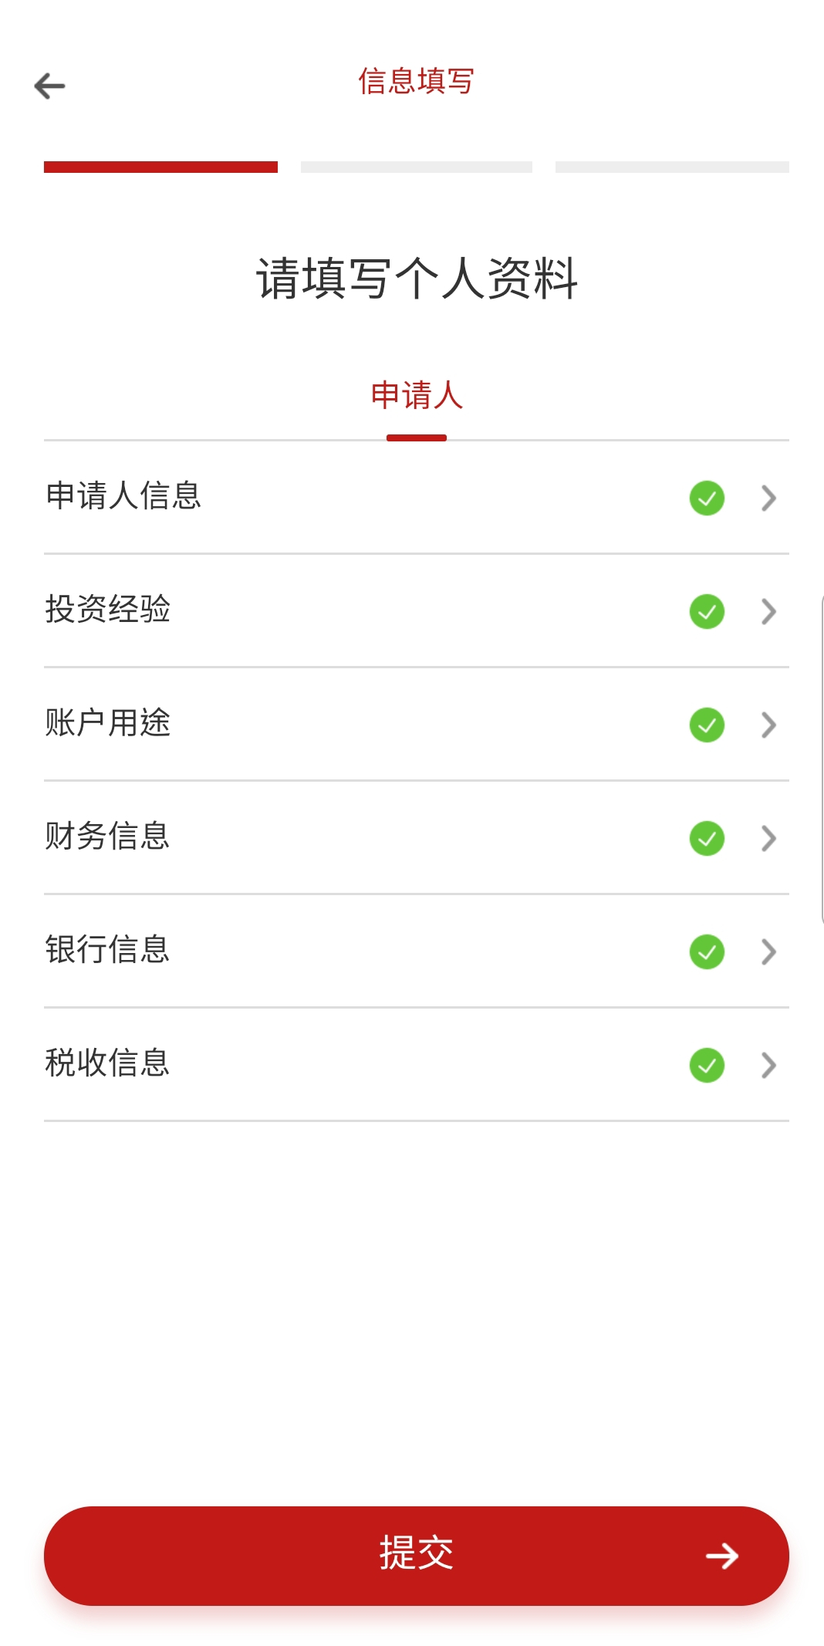
Step2 Prepare the documents and fill in the information
步骤2 按提示准备材料及填入信息
There are six parts in this step. It is suggested that you use English or PINYIN to fill out the information.
在这步骤中，一共有6个部分需要填写。华泰美国建议您在填写信息时使用英文或拼音。
You may be asked to sign the additional statements according to the provided information, if so, you need to download the statements and sign the EN version statements.
在填写的过程中，可能会需要您填写附加的声明，请根据要求下载并签署上传。任何附加声明请签署并上传英文版本，中文版本只作为填写时的参考。
© 2018 Huatai Financial USA, INC.
Notes:
首先，我们来看一下个人帐户开户

Slide 12
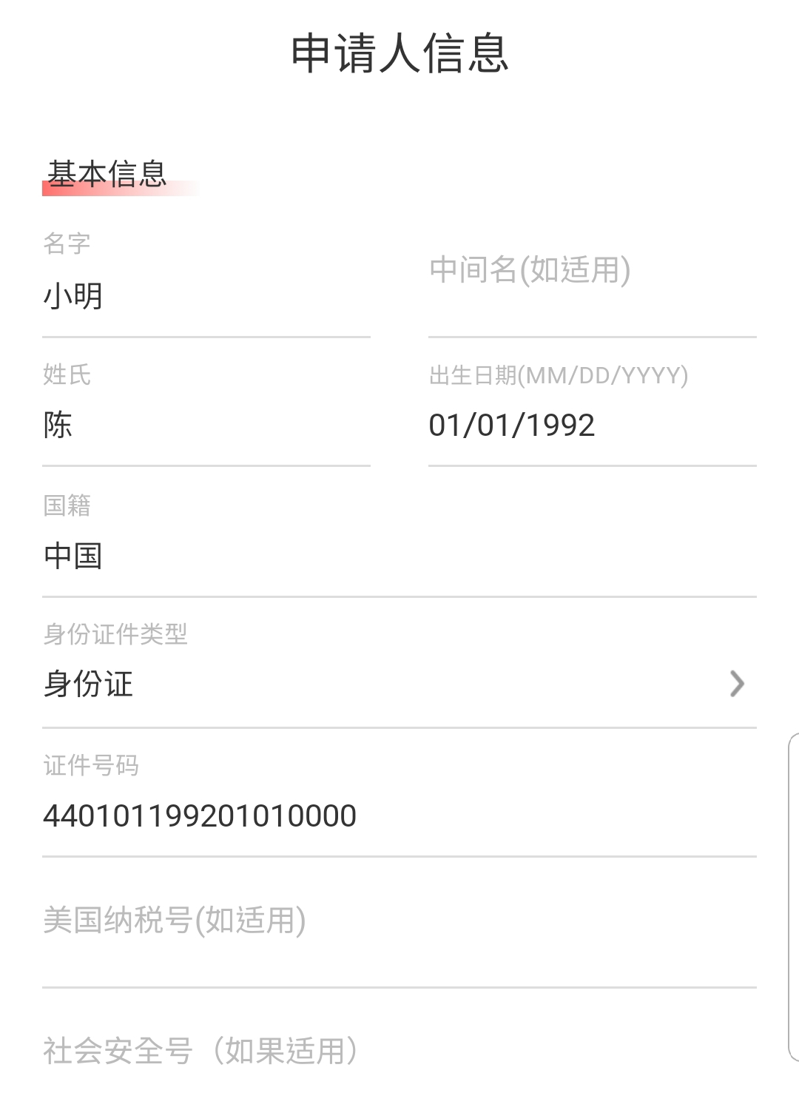
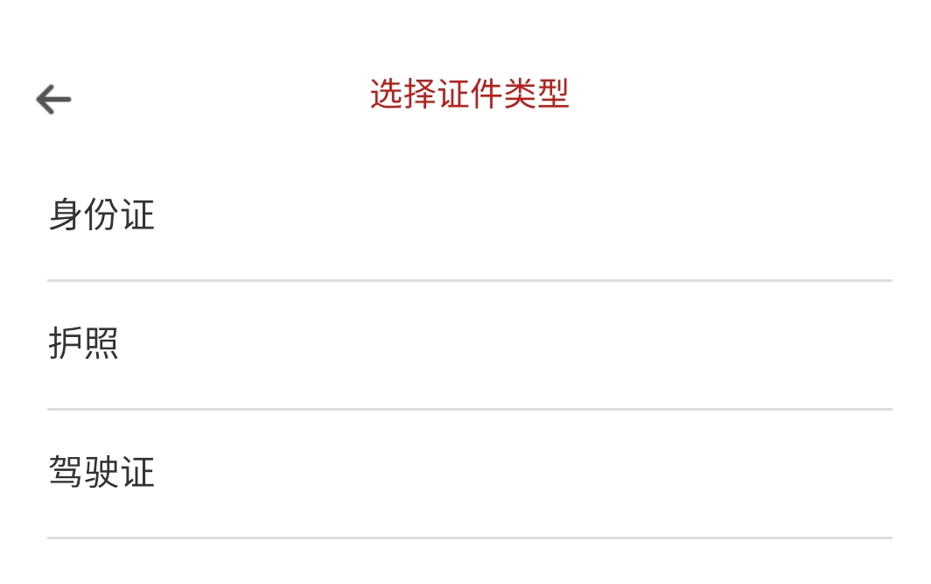
Step2 Prepare the documents and fill in the information
步骤2 按提示准备材料及填入信息
a. Application Information
申请人信息-基本信息
*You can select ID card/password/driver license as the ID document.
证件信息可以选择 身份证/ 护照 / 驾驶证作为身份证明文件
Date of birth need to be separated by “/”.
出生日期, 要在数字之间加“／”.
*Number of dependents is for KYC purpose.
供养人数是KYC的一部分。如无，可以填写0以继续开户。
© 2018 Huatai Financial USA, INC.
Notes:
首先，我们来看一下个人帐户开户

Slide 13
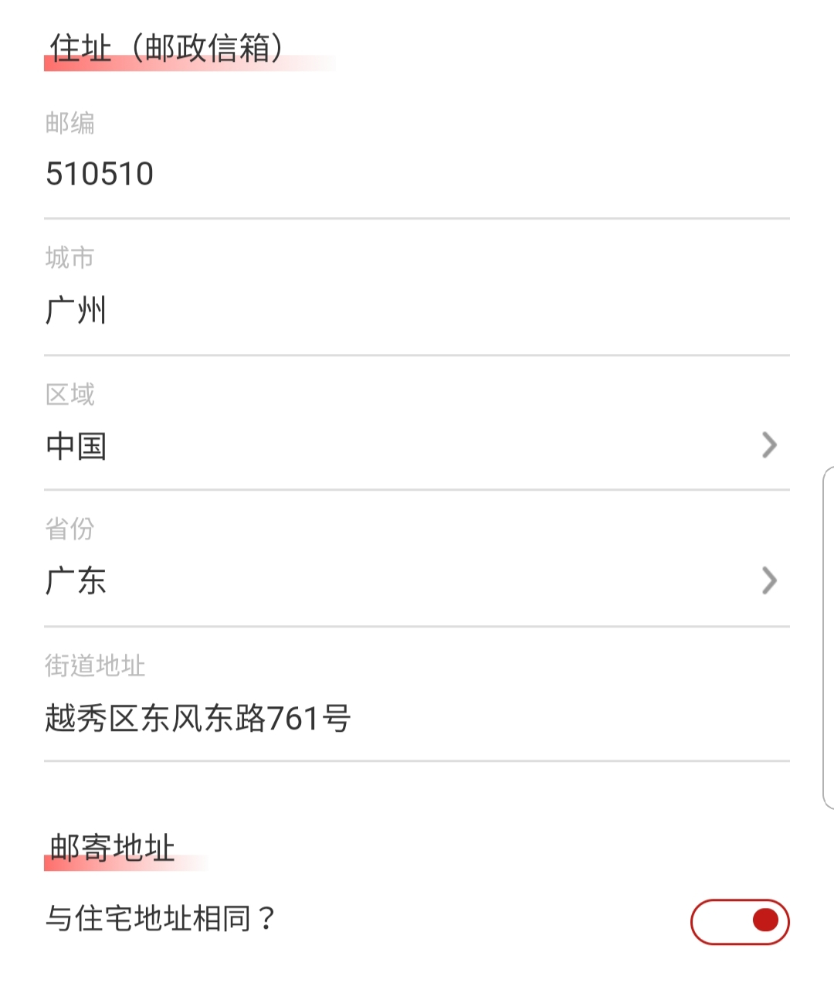
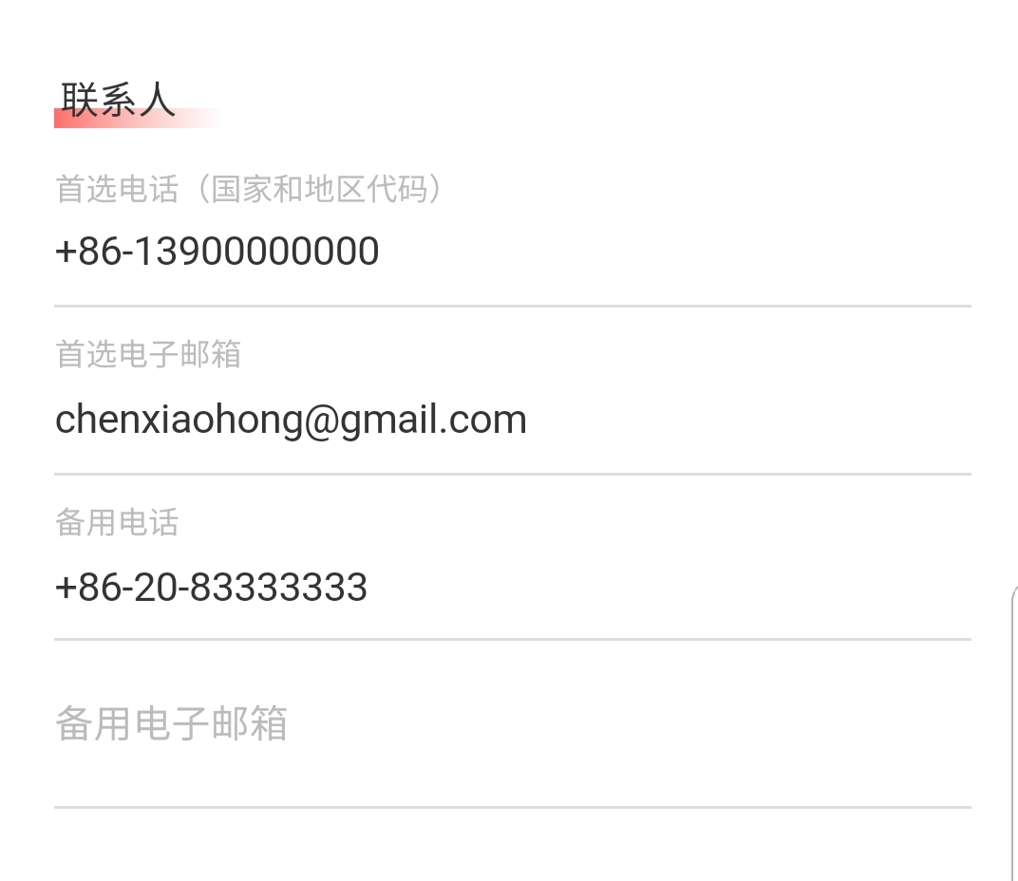
Step2 Prepare the documents and fill in the information
步骤2 按提示准备材料及填入信息
a. Application Information
申请人信息-通讯信息
*If you choose the “the mailing address is same as Residential Address”, there is no need to the provide a new address.
若邮寄地址与宅地址一致，您可以选择“邮寄地址与住宅地址相同”，则不需要提供新的邮寄地址。
*We suggest that you use your mobile number as the “Preferred Phone”.
首选电话，建议使用常用电话，便于我司工作人员能及时联系客户，因此推荐客户填写手机号码。
© 2018 Huatai Financial USA, INC.
Notes:
首先，我们来看一下个人帐户开户

Slide 14
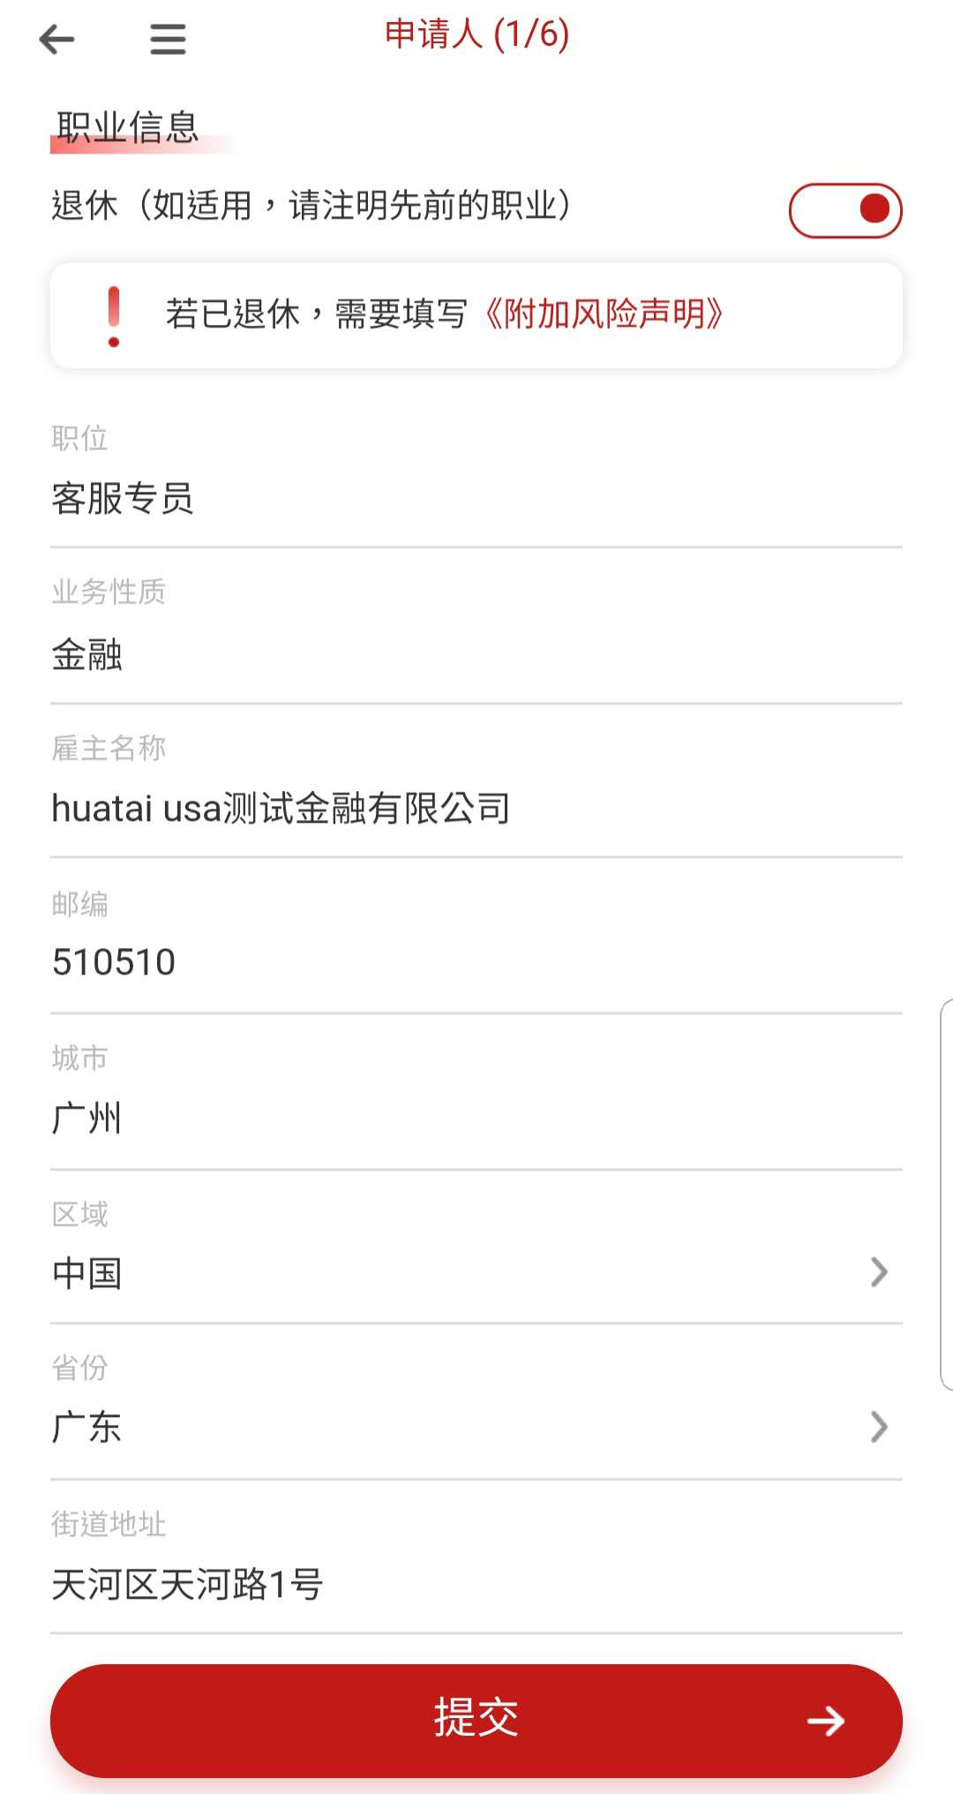
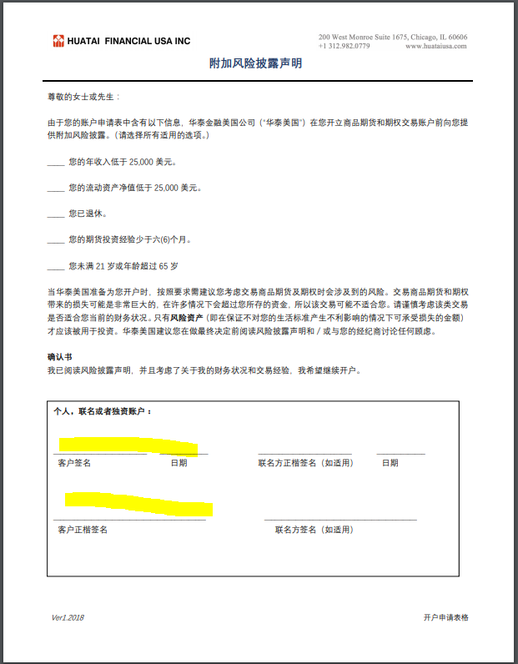
Step2 Prepare the documents and fill in the information
步骤2 按提示准备材料及填入信息
a. Application Information
申请人信息-职业信息
*If you are retired, you are required to fill out <Additional Risk Statement>, please note that the English version would prevail and you are required to sign the English version. Same logic applies to other additional documents you might encounter.
若客户已退休则额外需要填写《附加风险声明》。请注意声明以英文版为准，中文版只作为填写过程中的参考，你需要签署的版本为英文版。以下您可能遇到其他的附加文件，同理，您需要签署的是英文版。
© 2018 Huatai Financial USA, INC.
Notes:
首先，我们来看一下个人帐户开户

Slide 15
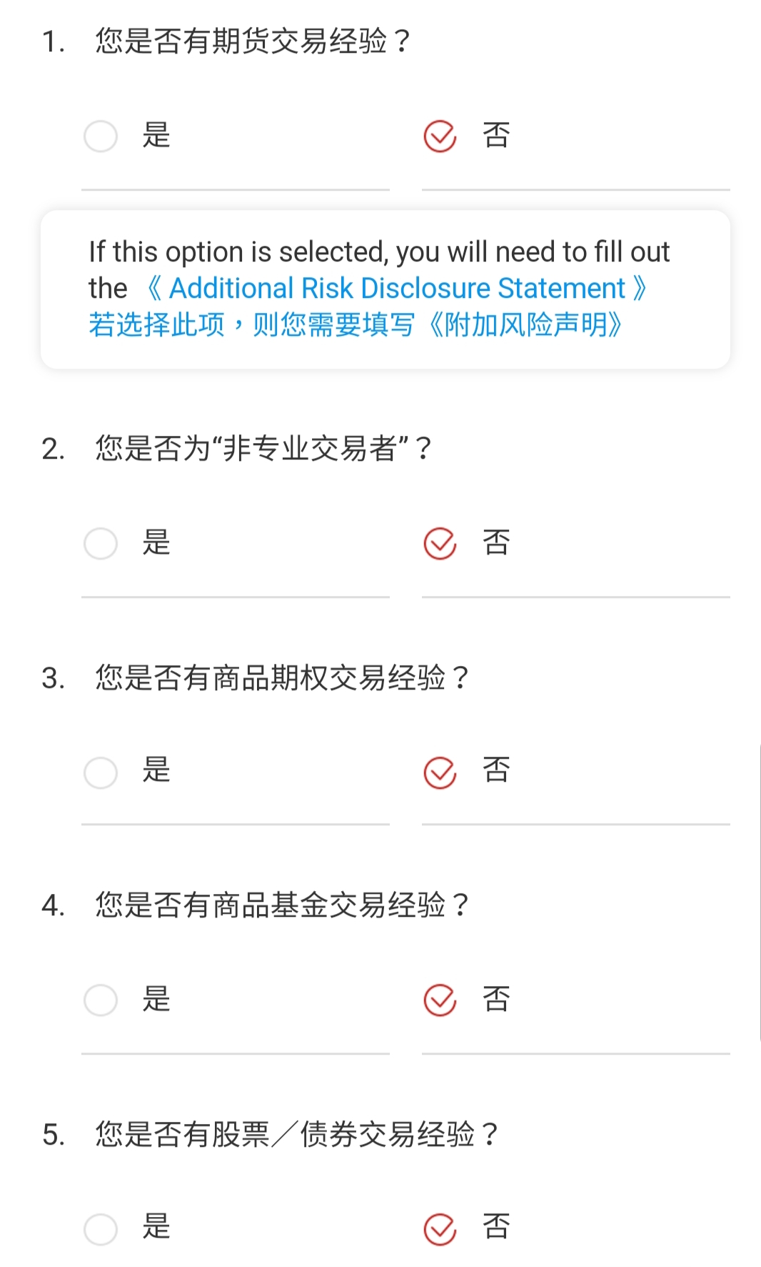
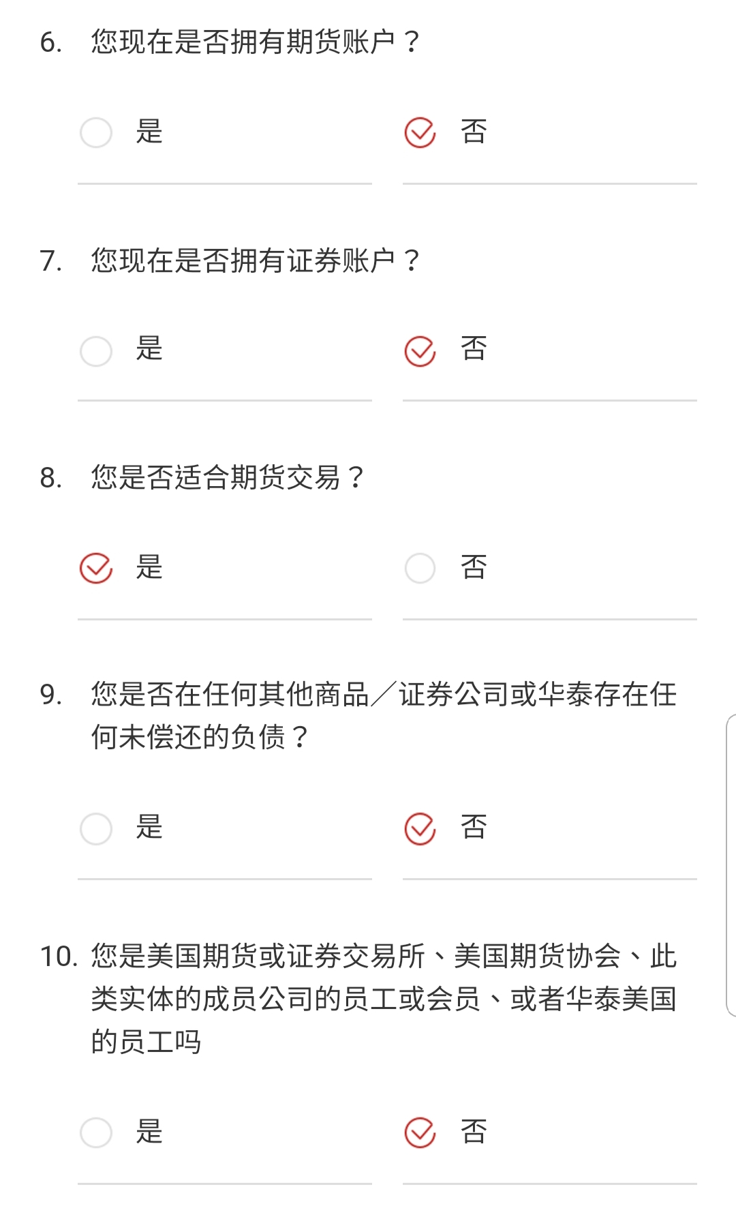
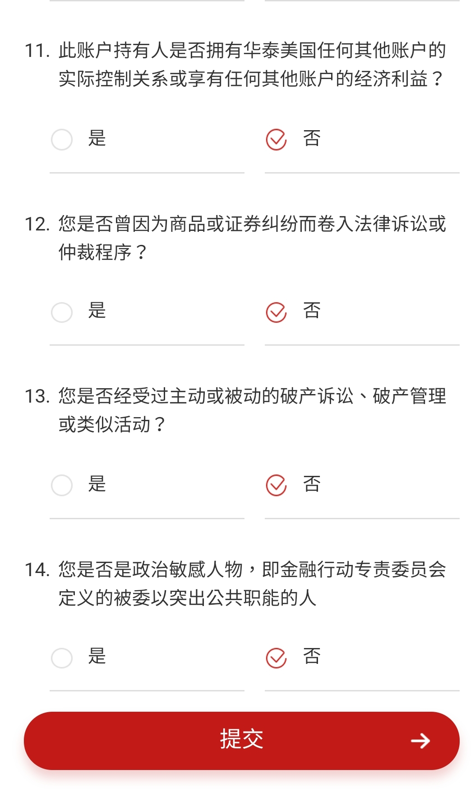
Step2 Prepare the documents and fill in the information
步骤2 按提示准备材料及填入信息
b. Investment Experience 投资经验
*If you have already had futures account or security account, you need to write down the brokerage name.
如果您在开户时已经拥有期货或证券账户，您需要写下经纪商的名字。
© 2018 Huatai Financial USA, INC.
Notes:
首先，我们来看一下个人帐户开户

Slide 16
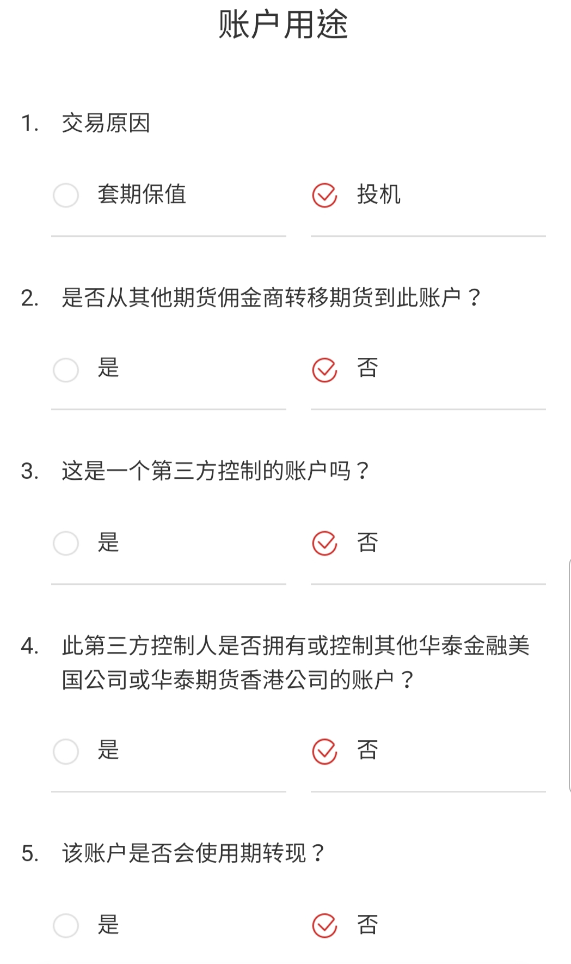
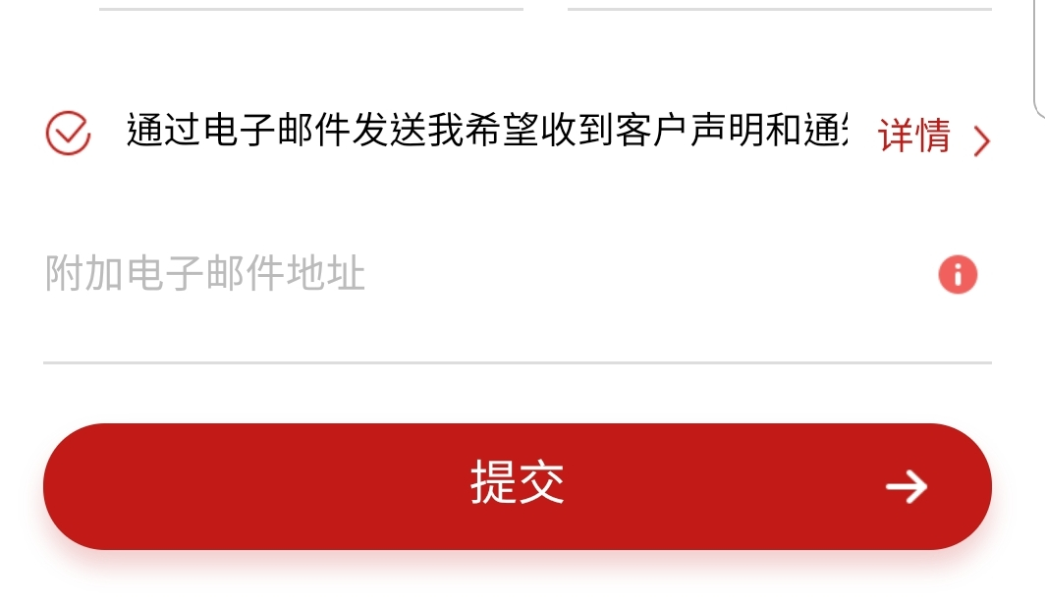
Step2 Prepare the documents and fill in the information
步骤2 按提示准备材料及填入信息
c. Account Usage 账户用途
*If you want an additional email address to receive duplicate Customer Statements and Notices, you can add the email address here. If you leave it blank, your preferred Email above will receive the Customer Statements and Notices.
如果您希望其他邮箱地址收到结单和通知，可以在此处填写。如果您在此留空，默认只有首选邮箱会收到结单及通知。
© 2018 Huatai Financial USA, INC.
Notes:
首先，我们来看一下个人帐户开户

Slide 17
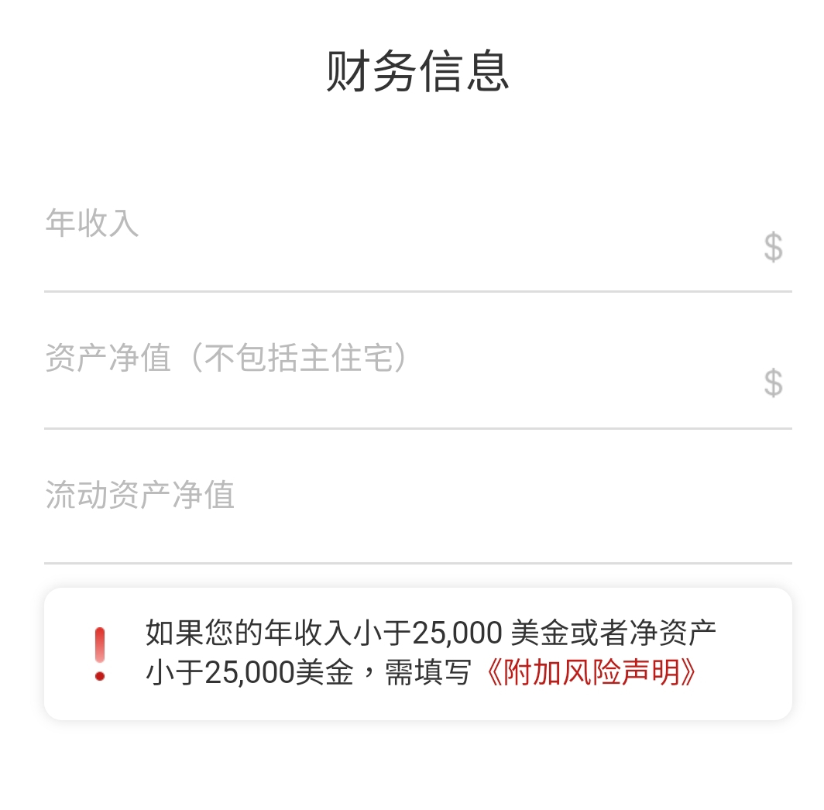
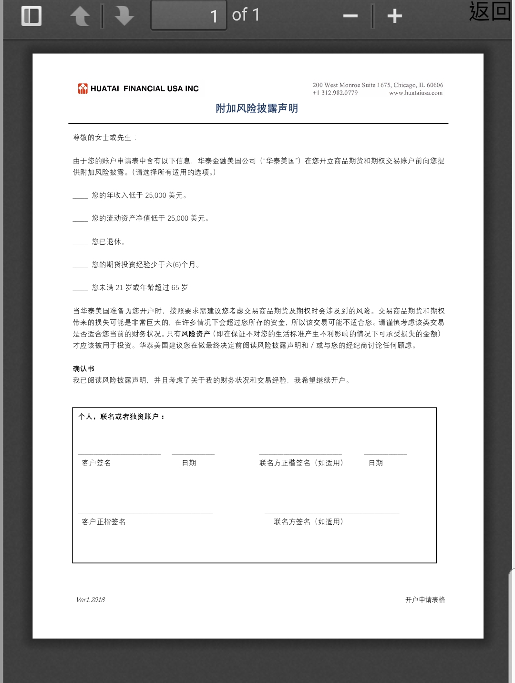
Step2 Prepare the documents and fill in the information
步骤2 按提示准备材料及填入信息
d. Financial Information 财务信息
*Fill the financial information based on the reality. If you do not meet the requirement, you need to sign the additional statement.
根据实际情况填写内容，如果需要签署附加声明，请完成资料填写后再下载并填写。
Click to view
点击可见
© 2018 Huatai Financial USA, INC.
Notes:
首先，我们来看一下个人帐户开户

Slide 18
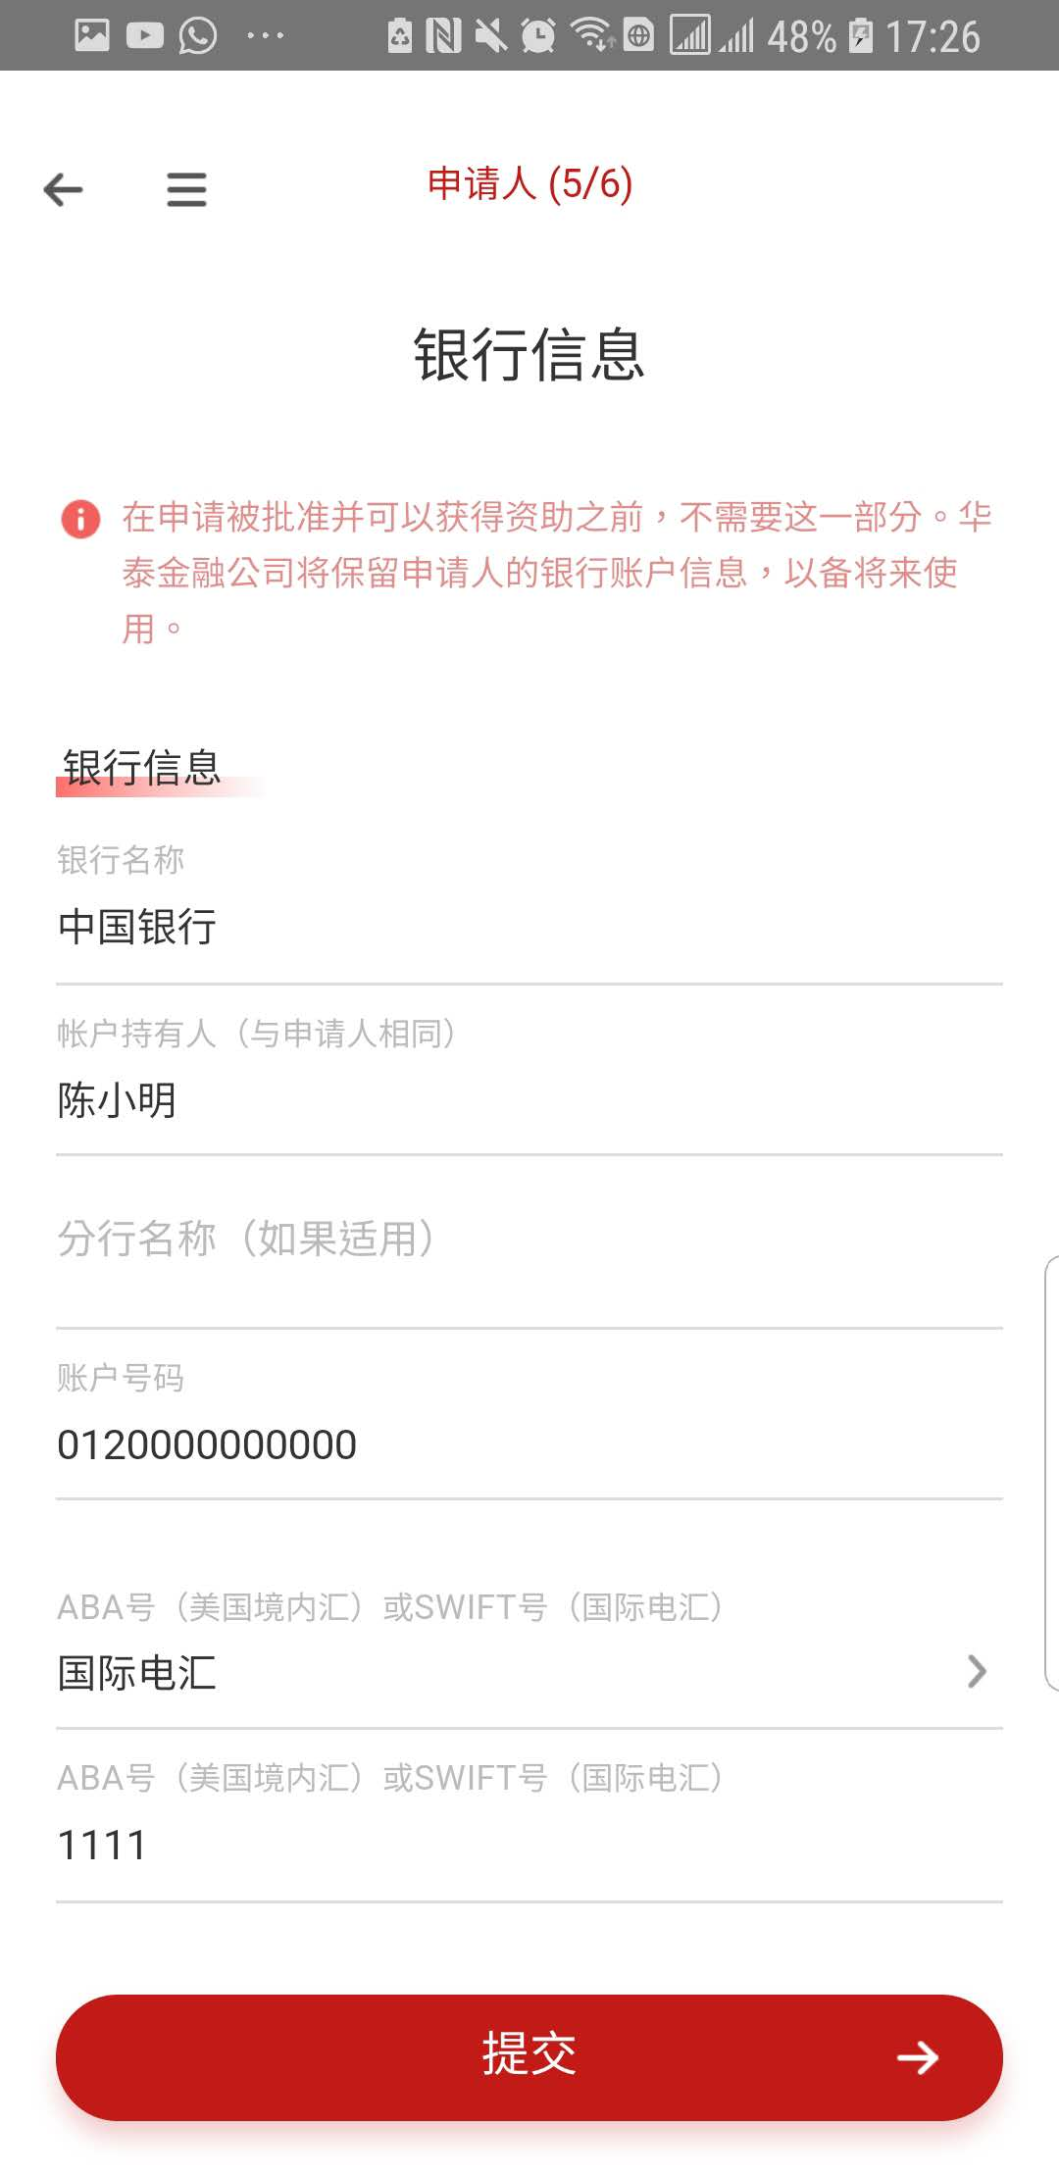
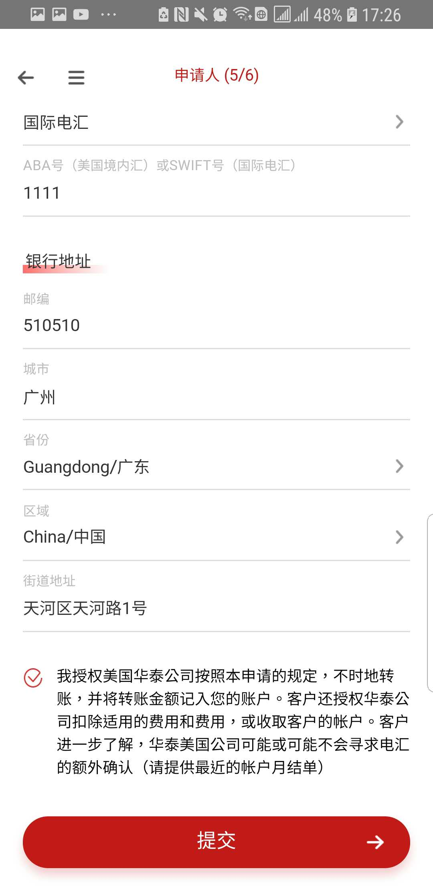
Step2 Prepare the documents and fill in the information
步骤2 按提示准备材料及填入信息
e. Bank Information 银行信息
Please choose the ‘ABA ROUTING’ if you register with a US domestic Bank. If you choose an outside US bank as your registered bank, please choose ‘SWIFT’.
如果您登记的银行是美国境内银行，请选择美国境内汇；
如果您登记的银行信息是美国境外银行，请选择国际电汇。
© 2018 Huatai Financial USA, INC.
Notes:
首先，我们来看一下个人帐户开户

Slide 19
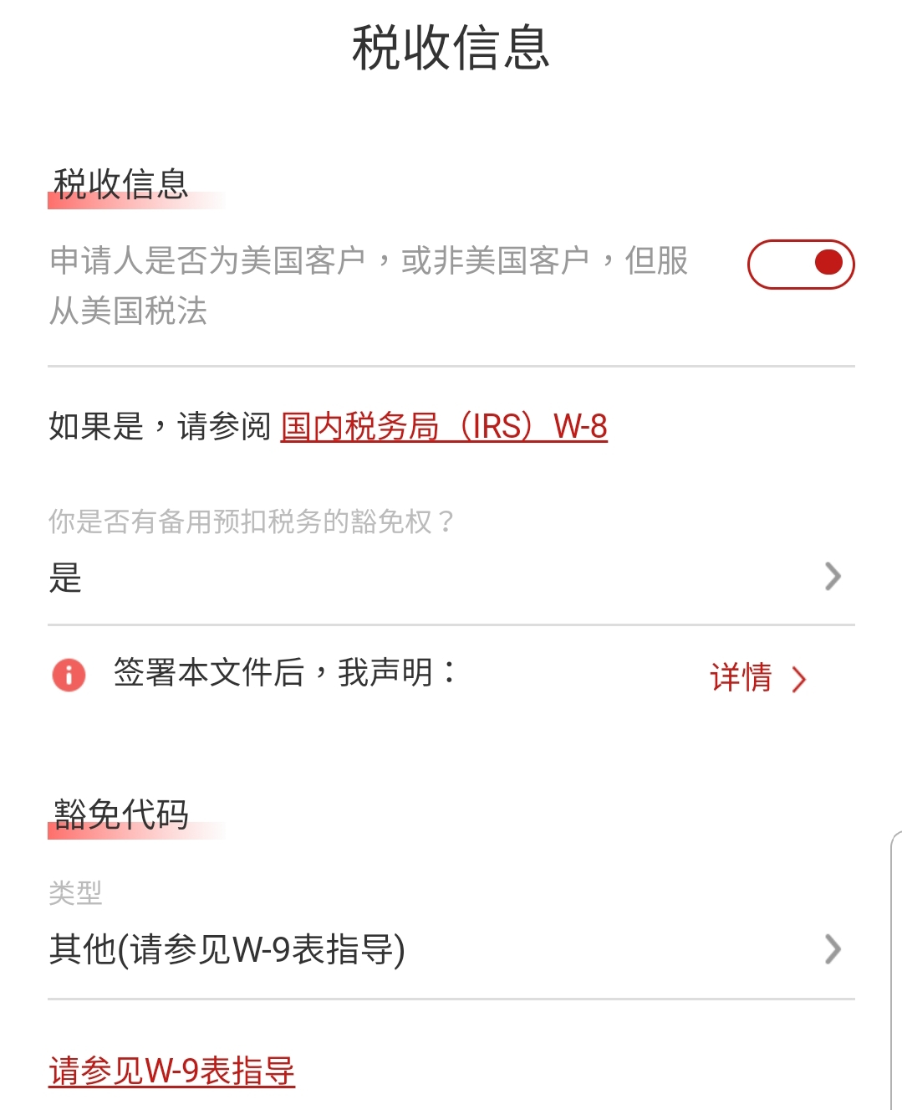
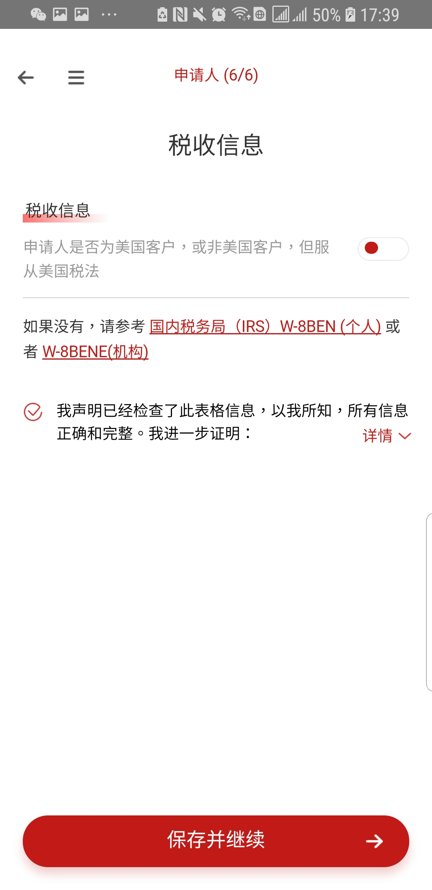
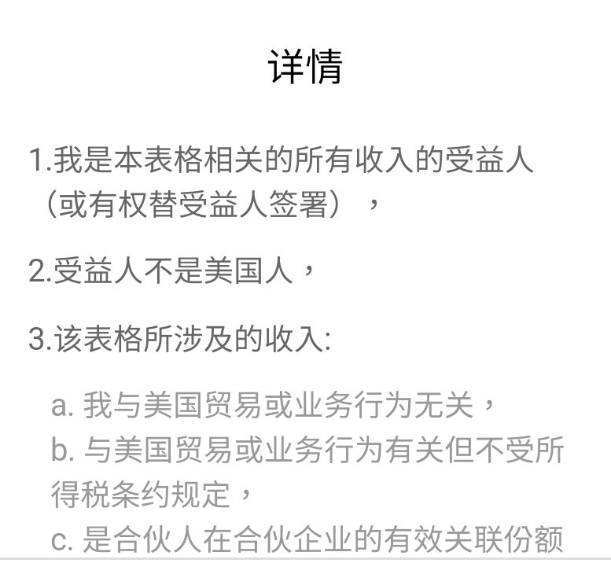
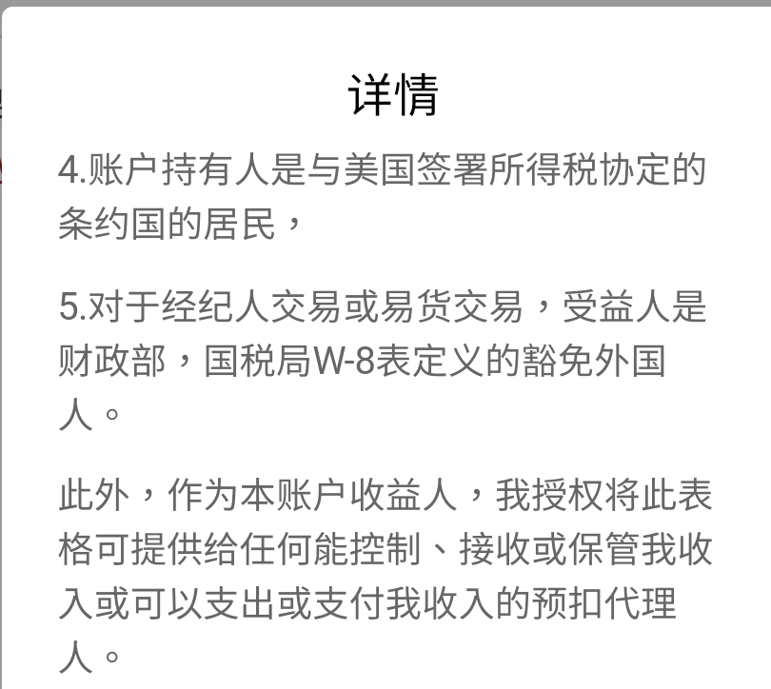
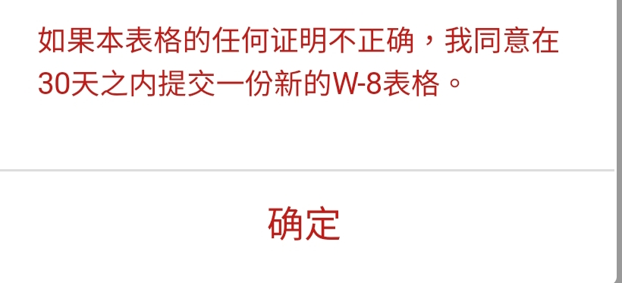
Step2 Prepare the documents and fill in the information
步骤2 按提示准备材料及填入信息
f. Tax Information 税收信息
*If YES, please fill in the information required. You don’t need to submit a separate W9 form to HTUSA.
如果此两处您均选择“是”，请填写相应豁免代码。您不需要另行向华泰美国上传提交W9表格。
*If No, please download the W-8BEN/W-8BENE form from the link above, fill in the information and submit it to HTUSA. The IRS only provide English version forms, but you can refer the Chinese version forms from the following link: W-8BEN (individual) / W-8BENE (Entity) (The Chinese version is from the Internet, and HTUSA is not responsible for the errors or omissions)
如果您此处选择“不是”，您将需要完成W-8BEN/W-8BENE表格填写，请填写后上传提交。美国国税局仅提供英文版表格，您可以通过以下链接获取中文对照版： W-8BEN (individual) / W-8BENE (Entity)（中文对照版从互联网获取，华泰美国不对该信息正确性及完整性负责）
© 2018 Huatai Financial USA, INC.
Notes:
首先，我们来看一下个人帐户开户

Slide 20
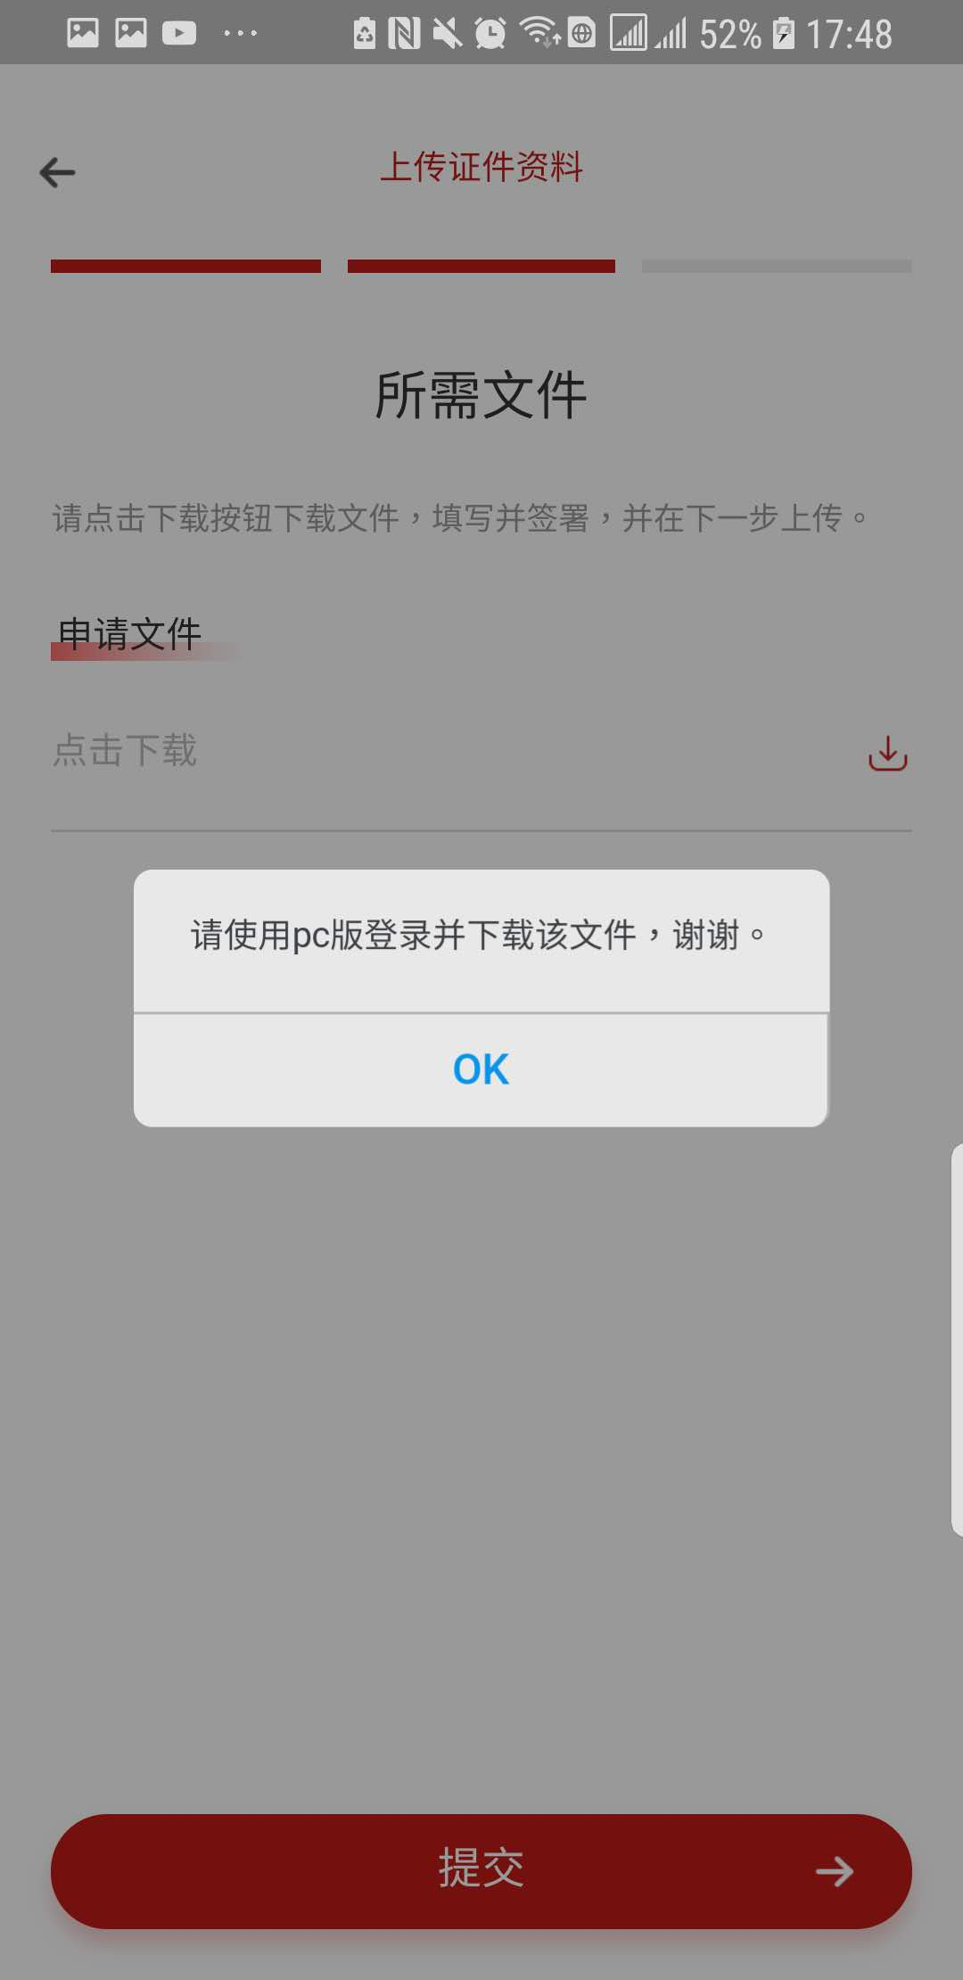
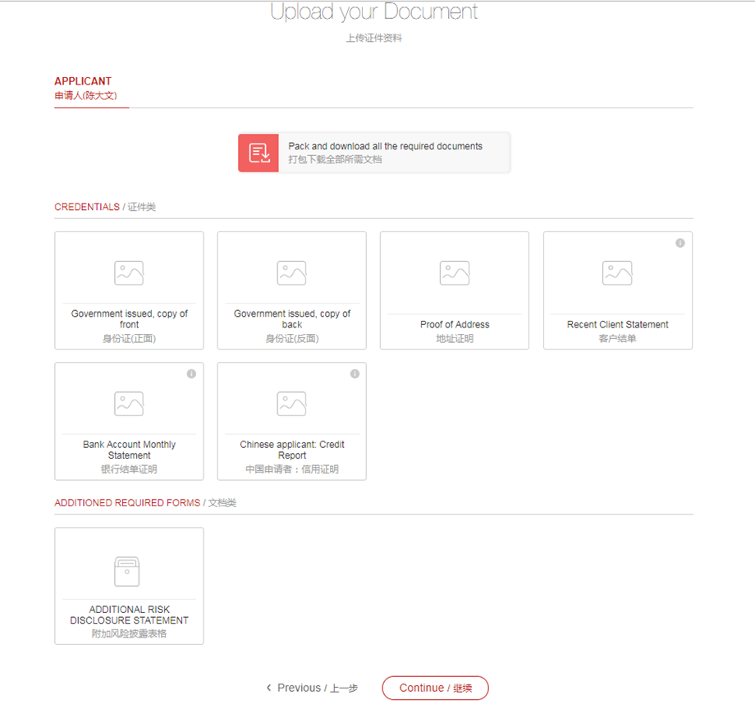
Step3 Download and upload the needed documents
步骤3 下载并上传所需文件
*Download 下载
*If there is any additional document needed to sign, you can download it in the PC version。
Due to system limitations, we are temporarily unable to download files through the mobile terminal.
在步骤2的资料填写中，如有任何需要额外签署的文件，需要登陆PC版进行下载并签署。
由于系统限制，手机端暂时无法下载文件。
© 2018 Huatai Financial USA, INC.
Notes:
首先，我们来看一下个人帐户开户

Slide 21
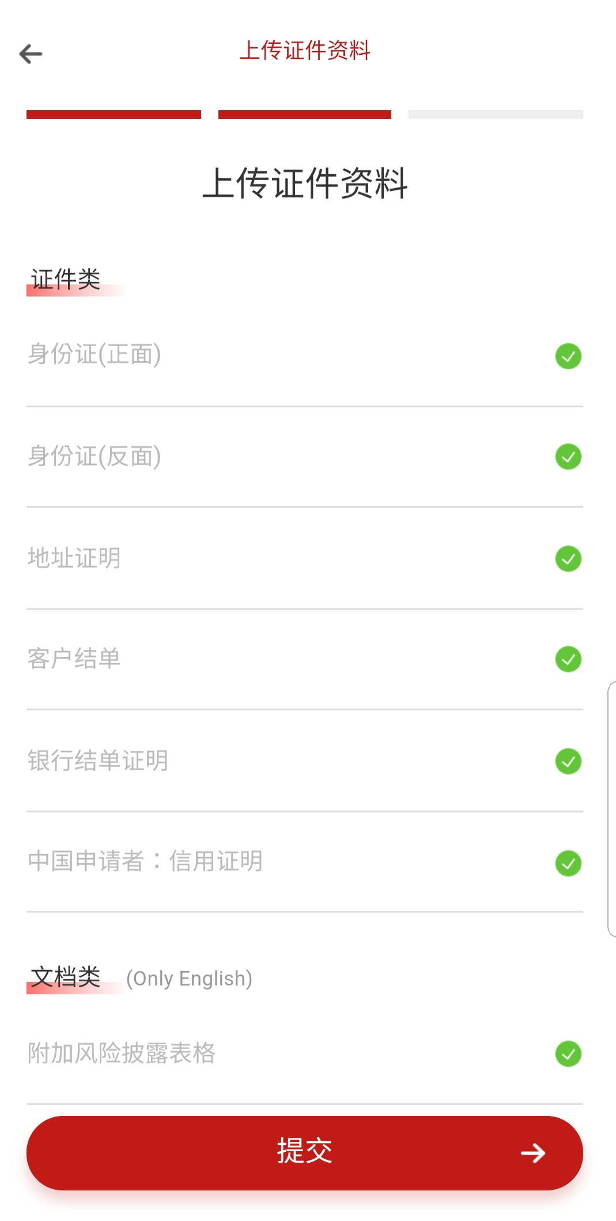
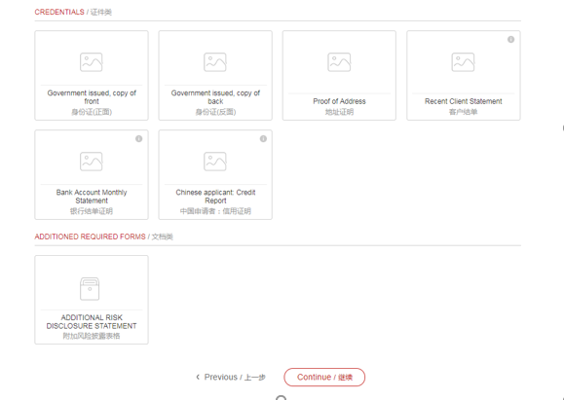
Step3 Download and upload the needed documents
步骤3 下载并上传所需文件
*Upload 上传
*You can upload the documents through APP or website. But you should be aware of the file format requirements for web page uploads.
你可以通过手机app或网页版上传文件，在使用网页版上传文件时，需要注意文件格式。
CREDENTIALS:
Only accept the image file type;
ADDITIONED REQUIRED FORMS:
Only accept the PDF file type.
网页上传限制：
证件类文件上传，限制为图片类型格式文件；
文档类文件上传，限制为PDF格式。
© 2018 Huatai Financial USA, INC.
Notes:
首先，我们来看一下个人帐户开户

Slide 22
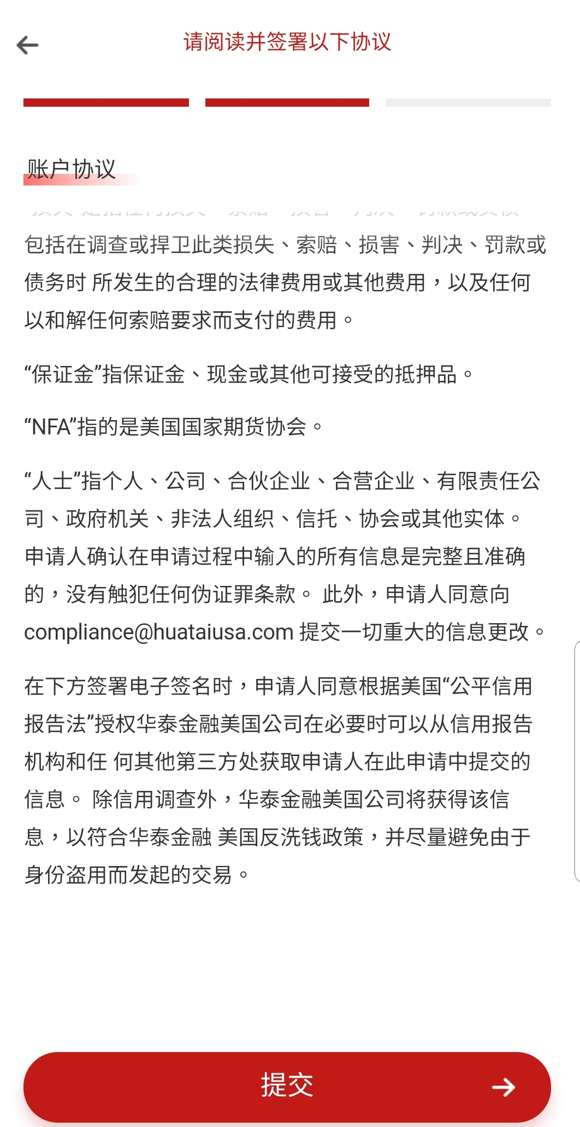
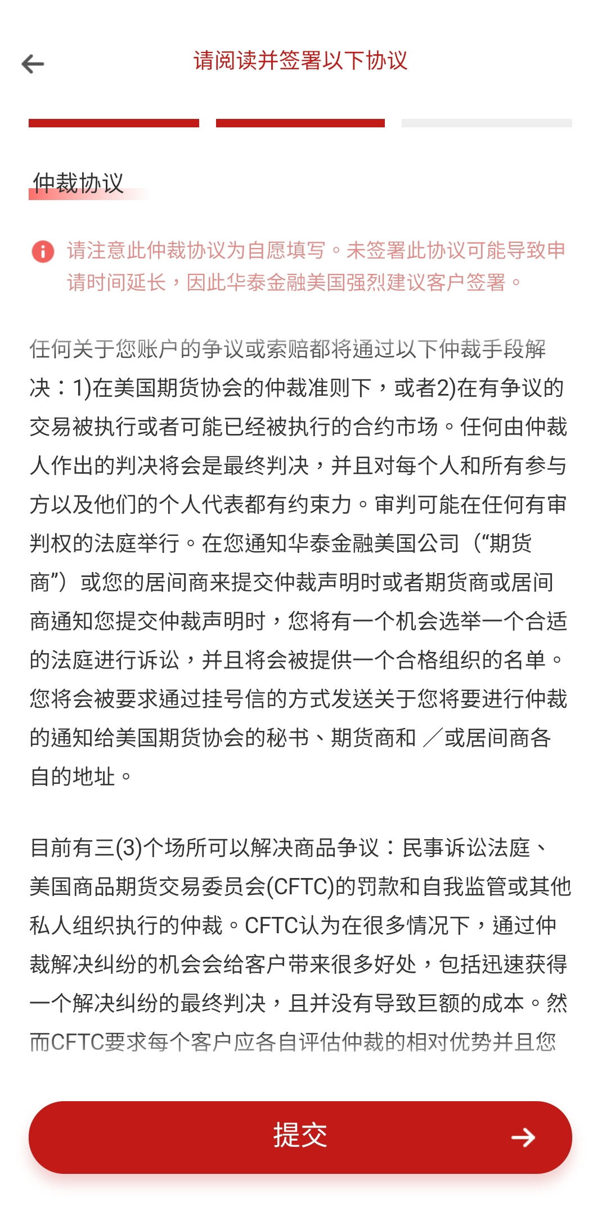
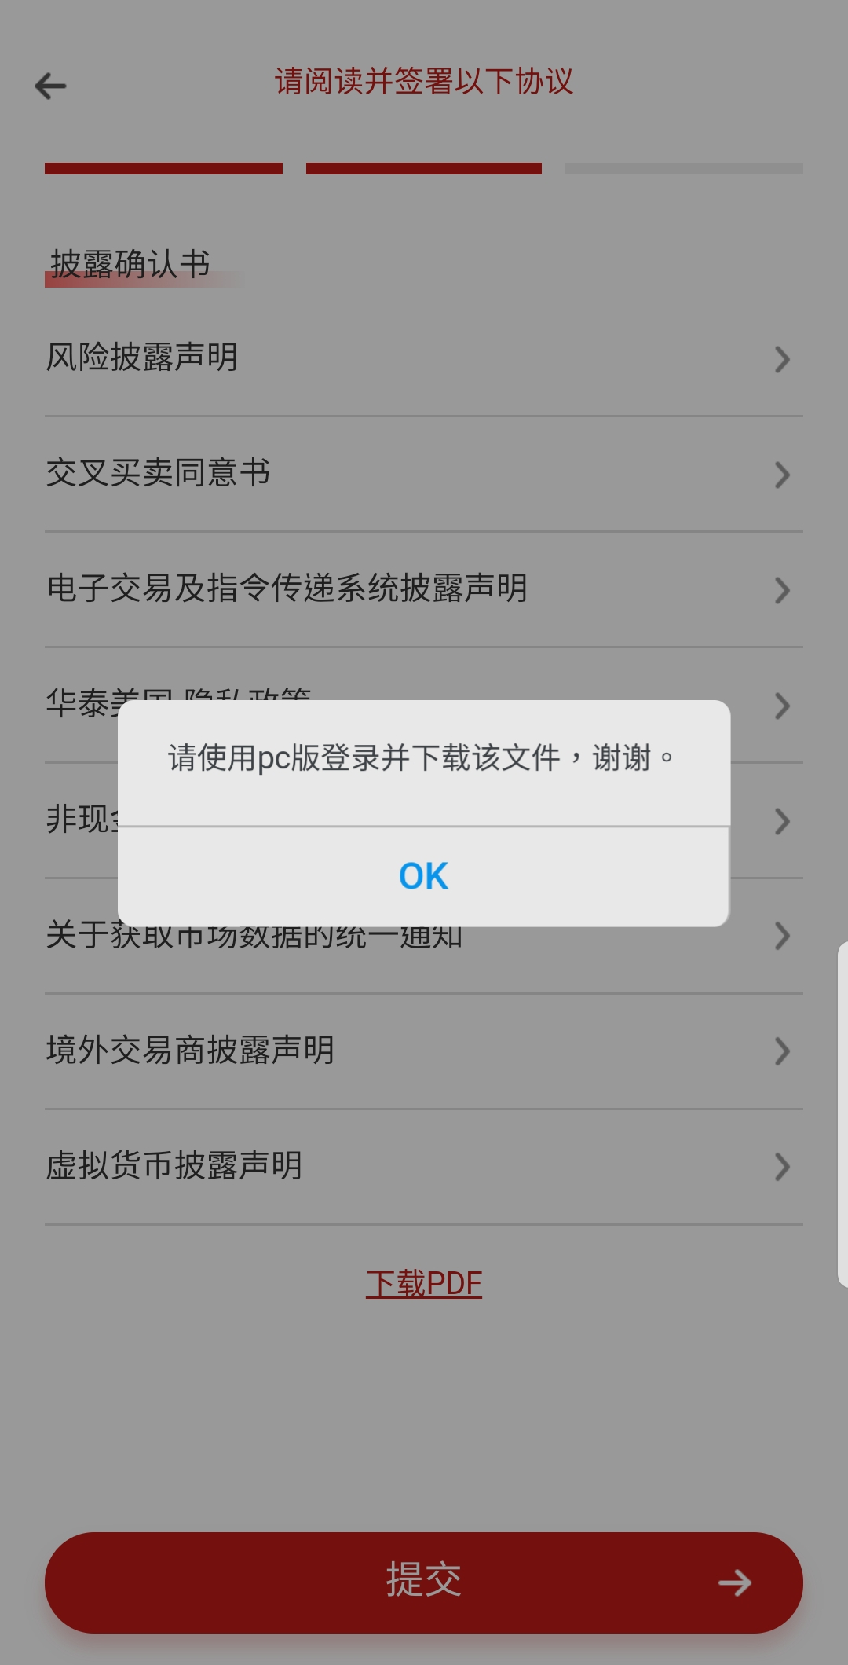
Step3 Download and upload the needed documents
步骤3 下载并上传所需文件
Read the relevant agreement and follow the prompts to log in to the web version to download and sign the file. Due to system limitations, the mobile terminal is unable to download files.
阅读相关协议并根据提示登陆网页版下载并签署文件。由于系统限制，手机端暂时无法下载文件。
© 2018 Huatai Financial USA, INC.
Notes:
首先，我们来看一下个人帐户开户

Slide 23
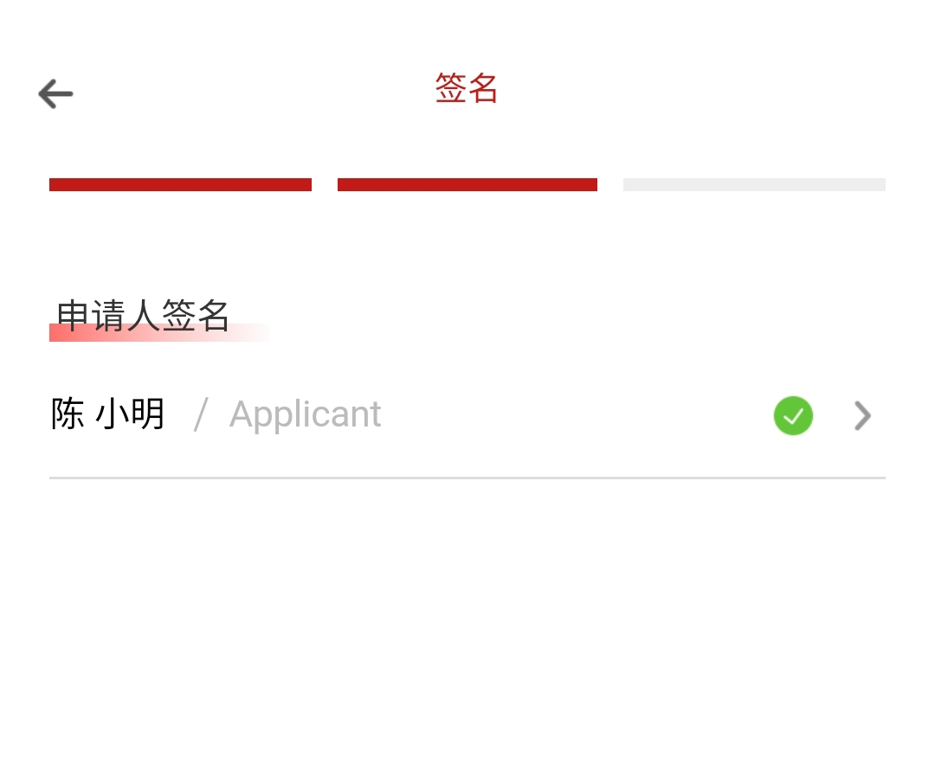
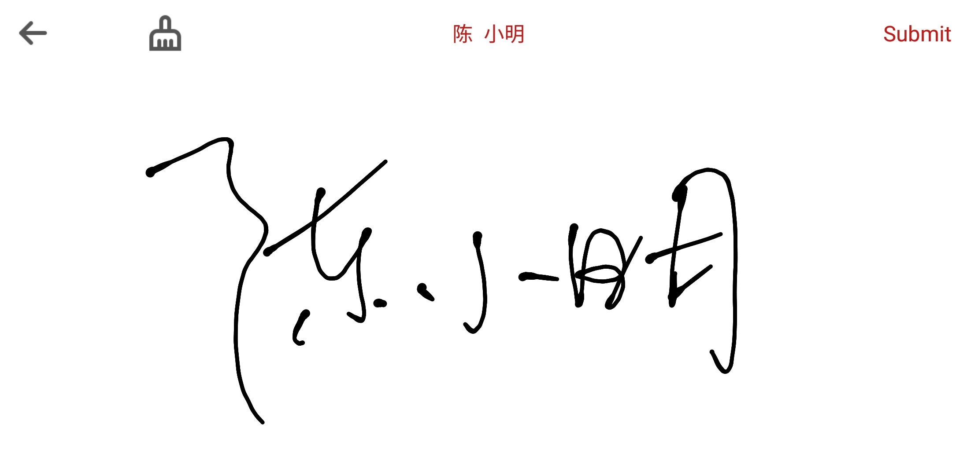
Step4 Sign
步骤4 签字
*After reading and confirming the agreements ,you can sign directly on the mobile app.
阅读完所有文件后，可在手机app上直接签字。
© 2018 Huatai Financial USA, INC.
Notes:
首先，我们来看一下个人帐户开户

Slide 24
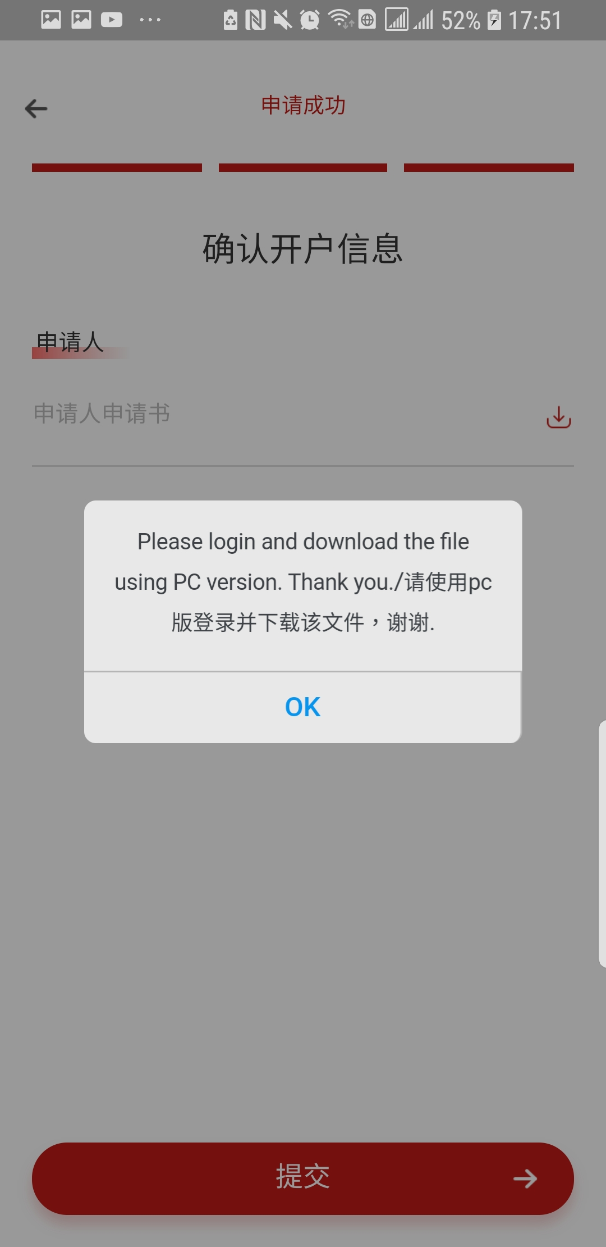
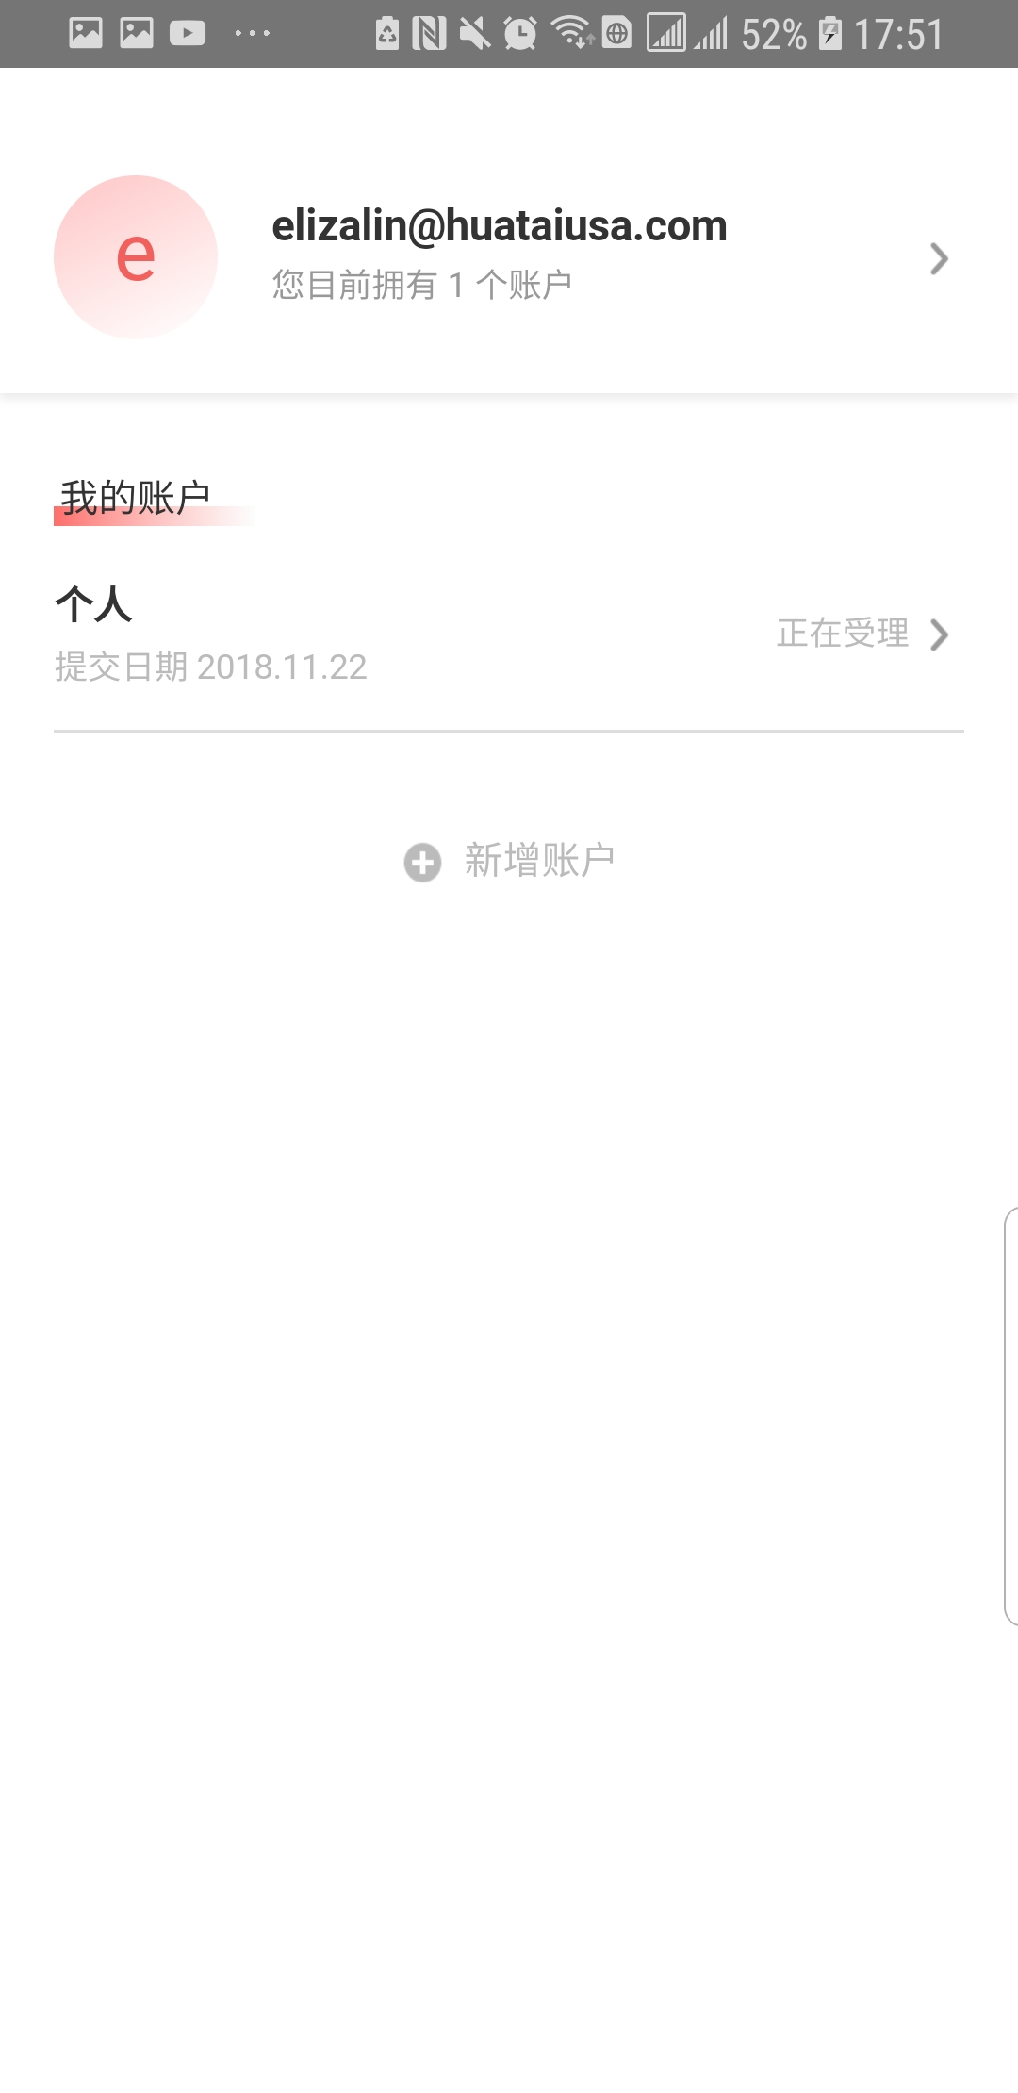
Step5 Complete Application
步骤5 完成开户
You can login the PC system to preview the application, if there is no need to change any thing, YOU can go to the next step.
可登陆至电脑版的开会系统对开户信息进行查看，查看后若无其他需要更改的信息，可继续至下一步。
Your application is completion and processing when you come to this step. Please click ‘Finish’ and wait for the result.
在这一步意味着您的开户申请已经完成, 工作人员将会对您的材料进行审核。
请直接点击“完成”并等待申请结果。
© 2018 Huatai Financial USA, INC.
Notes:
首先，我们来看一下个人帐户开户

Slide 25
JOINT 联名
© 2018 Huatai Financial USA, INC.
Notes:
首先，我们来看一下个人帐户开户

Slide 26
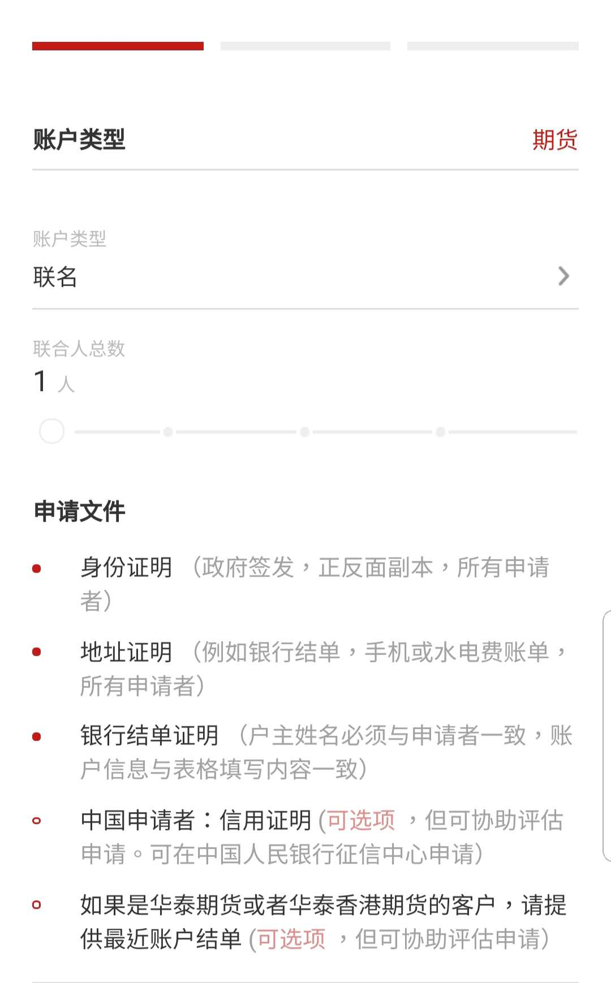
Joint ACCOUNT 联名账户
*The default number of Joint Persons is 1. If the client want to open an account with more than 1 person, client need to apply to HUATAI USA.
选择联名账户为客户类型时，系统默认联名人数为1。如果联名人数量超过1，需要向华泰美国申请。
*Application Documents for Joint Account.
联名账户所需文件
© 2018 Huatai Financial USA, INC.

Slide 27
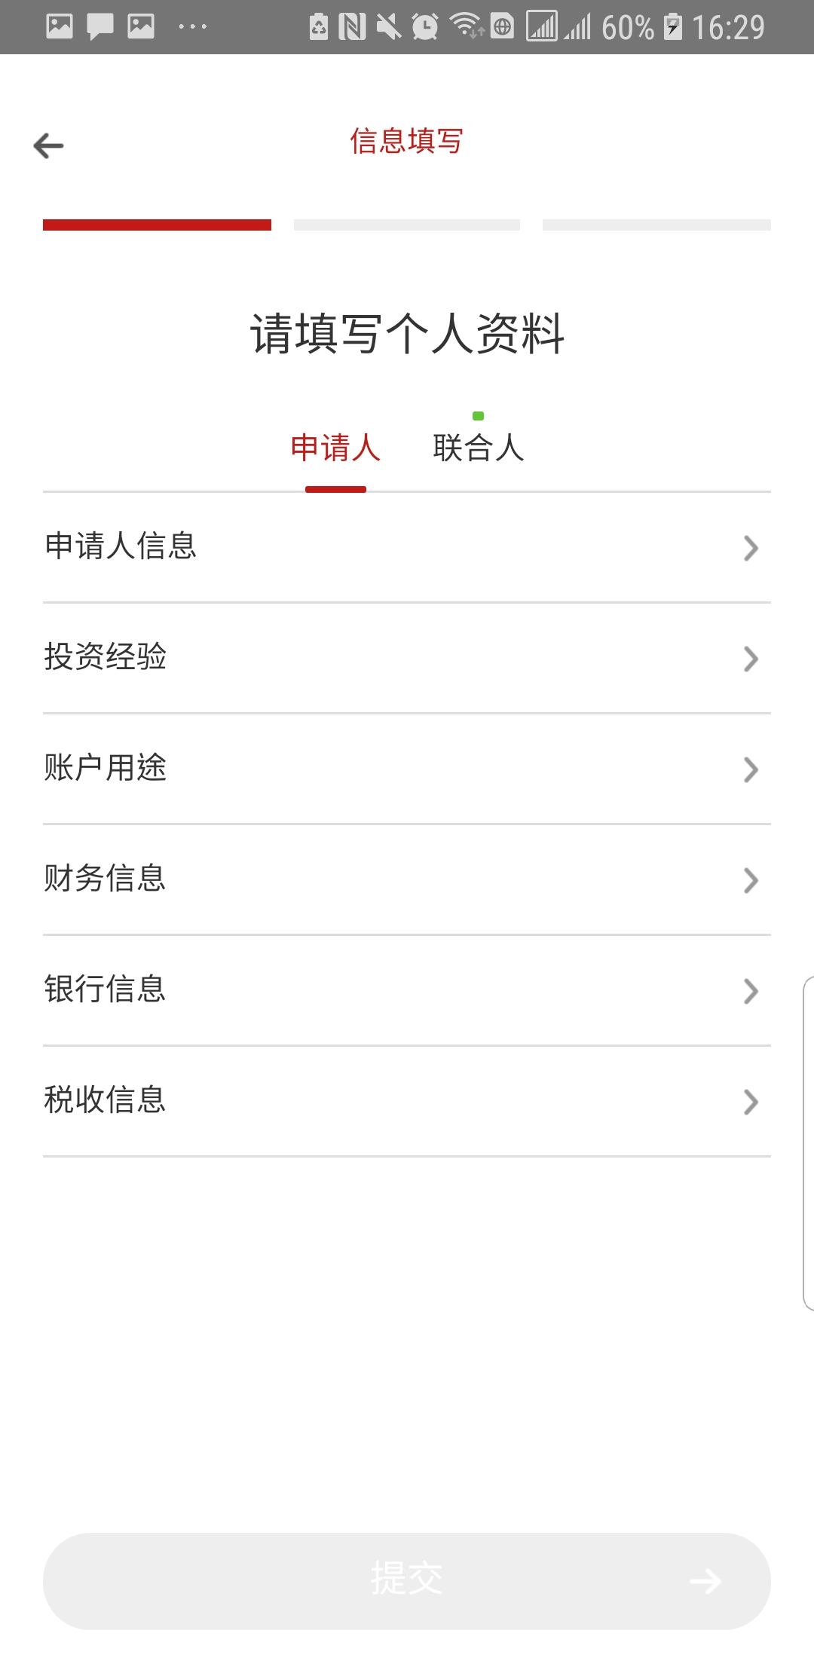
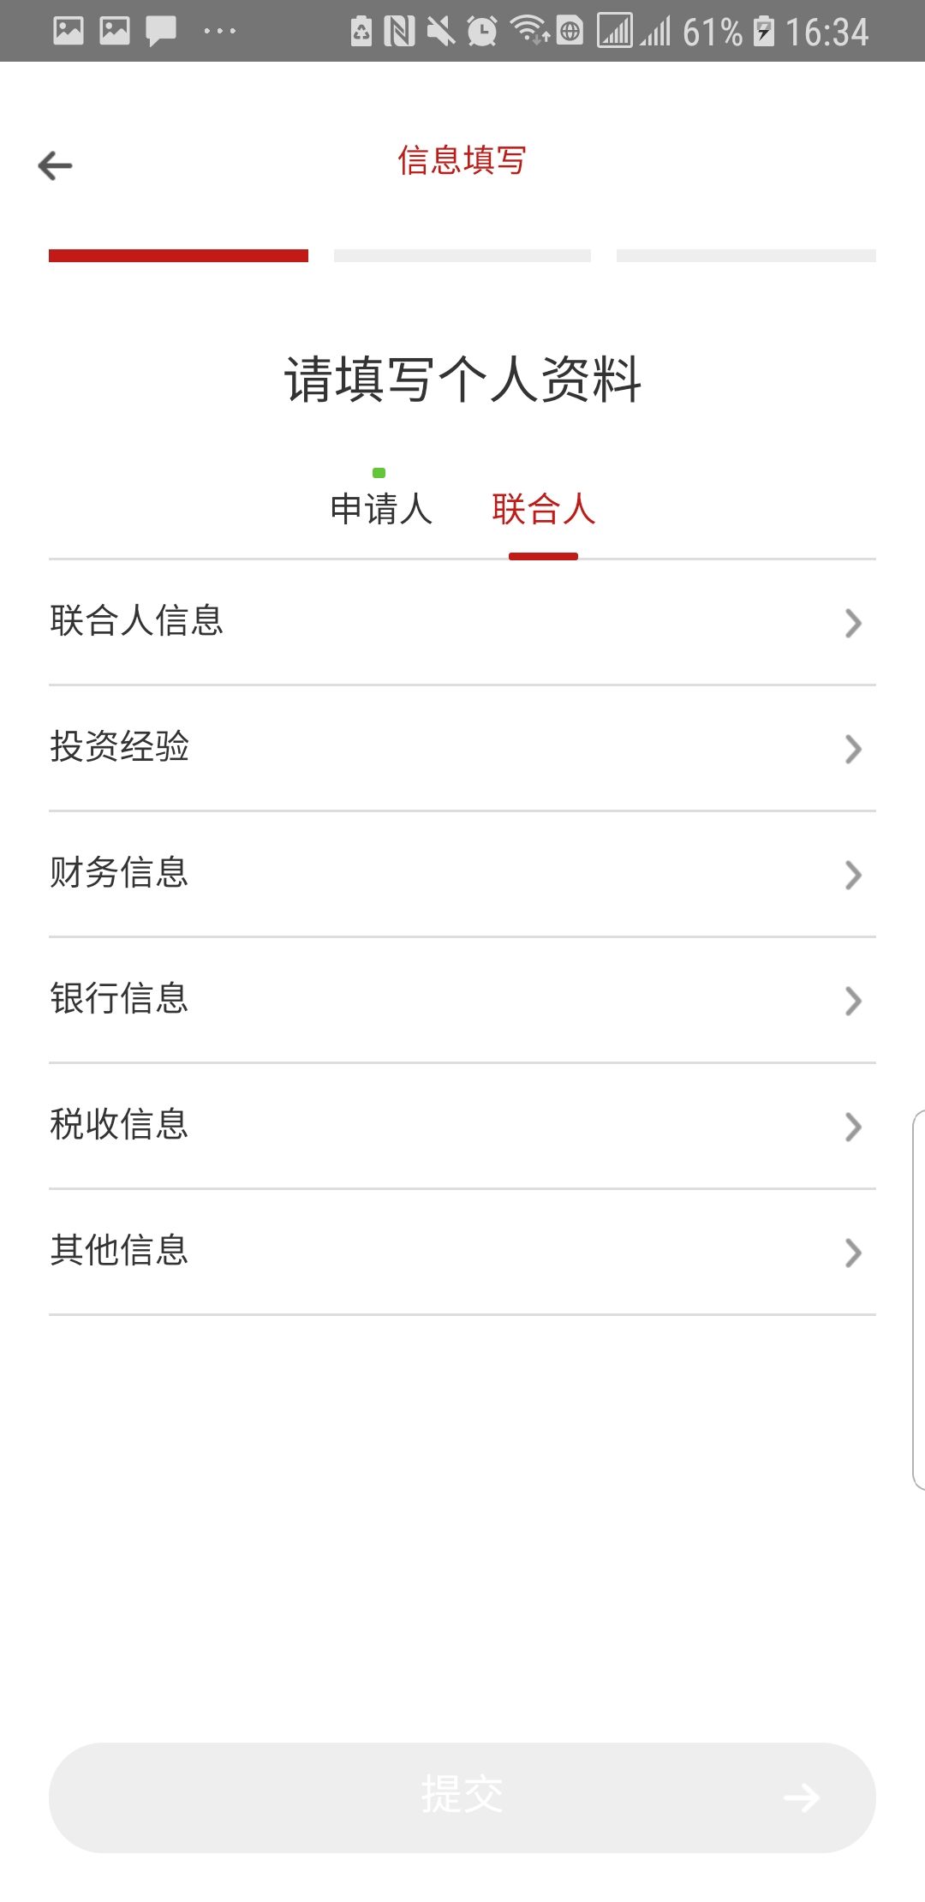
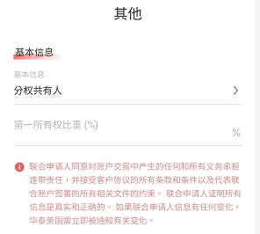
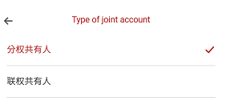
Joint ACCOUNT 联名账户
*Fill in the information of the applicant and joint person separately , including personal information, investment experience, financial information, bank information, tax information and the others.
Please refer to the personal account opening section for details.
*申请联名账户，需要填写申请人信息，和联名人信息。包括个人信息、投资经验、账户用途、财务信息、银行信息、税务信息及其他信息都分别填写。
有关填写内容与注意事项请参考个人开户部分。
The joint person can fill out the other bank information if the information is different from the first owner's bank account.
联名人的银行信息可以和第一所有着的银行不同，如果一致则不需要填写。如果不一致，则可以填写新的银行信息。
*If this joint account type is Tenants-In-Common, the joint person should write down the ownership percentage.
如果该账户类型是分权共有人，联名人都需要在开户是写下第一所有权的比重。
© 2018 Huatai Financial USA, INC.

Slide 28
SOLE PROPRIETORSHIP 独资公司
© 2018 Huatai Financial USA, INC.
Notes:
首先，我们来看一下个人帐户开户

Slide 29
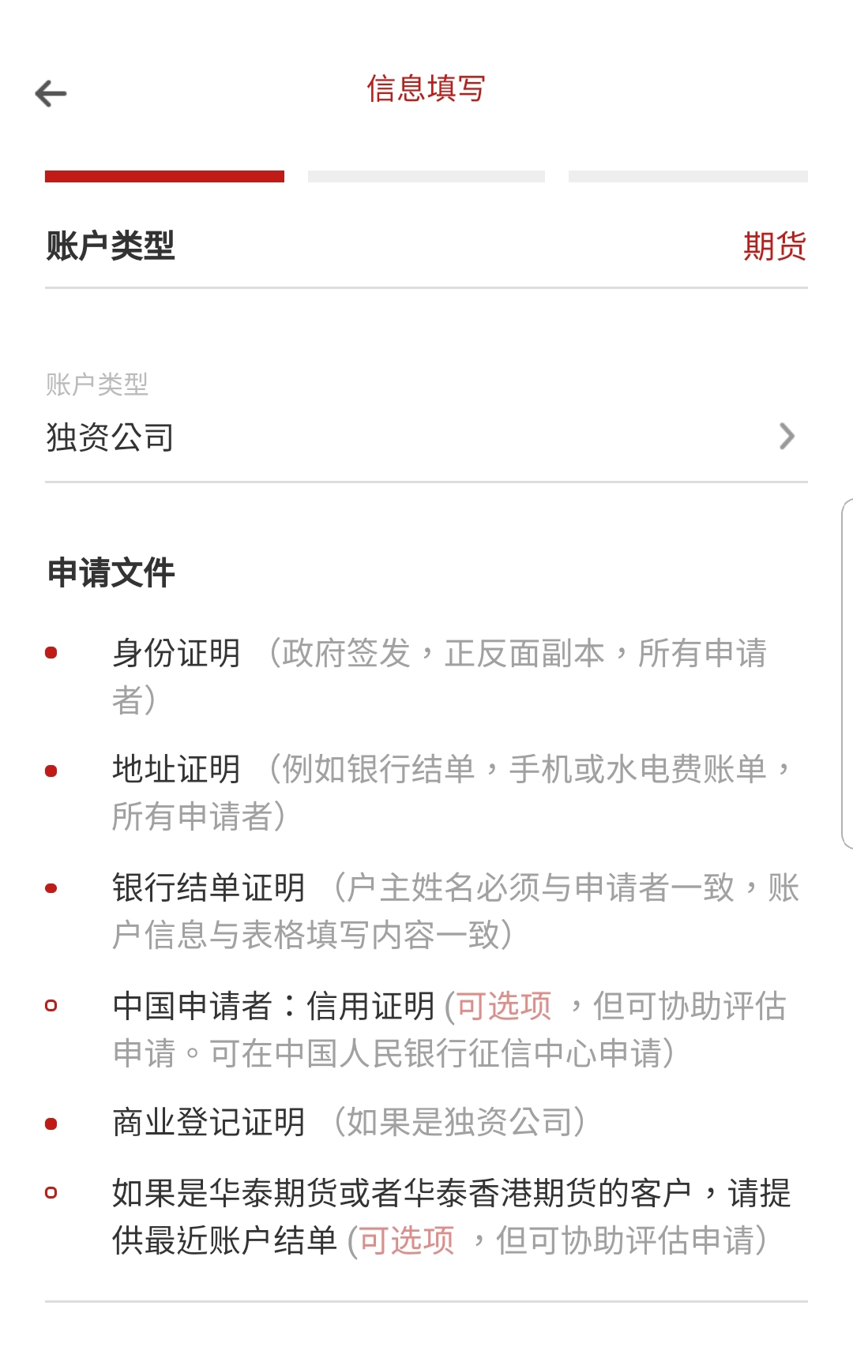
SOLE PROPRIETORSHIP 独资公司
*Application Documents for SOLE PROPRIETORSHIP .
独资公司账户所需文件
© 2018 Huatai Financial USA, INC.

Slide 30
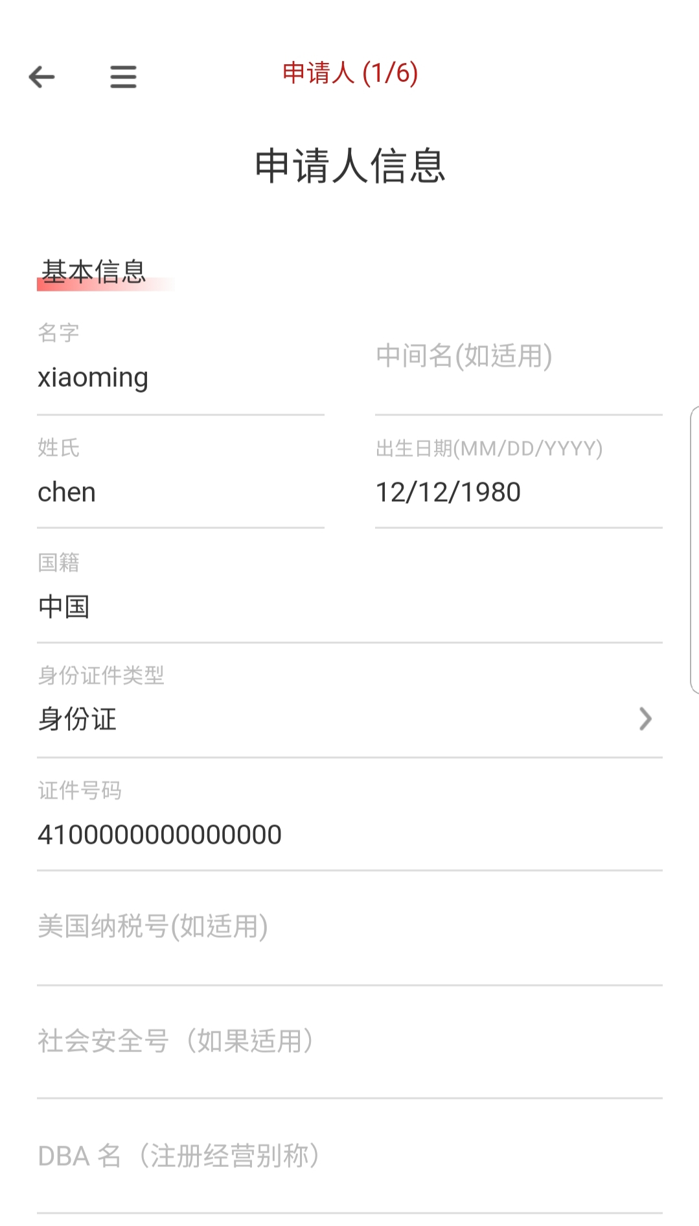
SOLE PROPRIETORSHIP 独资公司
© 2018 Huatai Financial USA, INC.

Slide 31
CORPORATE 公司
© 2018 Huatai Financial USA, INC.
Notes:
首先，我们来看一下个人帐户开户

Slide 32
Application documents 申请所需文件
There are seven parts in this step. Huatai USA encourage you to use English or PINYIN to fill out the information.
在机构开户这步骤中，一共有7个部分需要填写。华泰美国鼓励您在填写信息时使用英文或拼音。
You may be asked to sign the additional statements according to the provided information, if so, you need to download the statements and sign the EN version statements.
在填写的过程中，可能会需要您填写附加的声明，请根据要求下载并签署上传。任何附加声明请签署并上传英文版本，中文版本只作为填写时的参考。
© 2018 Huatai Financial USA, INC.

Slide 33
Entity Information 填写机构资料
*Please fill in the entity information required.
请按要求填写机构信息。
*Please note if there is an individual who own 10% or more interest in the entity, you are required to list such individual.
如果机构中有控股超过10%及以上的个人，需要单独列出。
© 2018 Huatai Financial USA, INC.

Slide 34
Entity Information 填写联系信息
*Fill in the contact information
请填写联系人信息
*Please add the country and area code for phone number
请在填写电话号码时加上国家号／区号
*Fill in the Number of Dependent, if there is no dependent, you can fill in 0.
若没有供养人，可以填写0，继续进行开户。
© 2018 Huatai Financial USA, INC.

Slide 35
Investment experience 填写投资经验
*If you have no experience trading futures, you are required to fill out the <Additional Risk Disclosure Statement>
如果您没有投资期货经验，请填写《附加风险声明》
*If you designate yourself as “Non-professional Trader”, you are required to fill out the <Non-professional Self-Certification Form>
如果您是非专业交易者，请填写《非专业交易者自我认证表格》
*Please note that you are required to sign and submit the EN version; CH version is for your reference.
请注意您需要签署并提交的是英文版本的附加文件；中文版仅供您填写时参考
*If you have any experience trading, you are required to write down the year for trading.
如果您在交易方面有任何经验，您需要根据要求写下交易的年份。
*If you have any other security or future account, you are required to write down the name of brokerages.
如果您有任何其他的证券、期货账户，你需要写下经纪商的名字。
© 2018 Huatai Financial USA, INC.

Slide 36
Investment experience 填写投资经验
* If there is any situation that meets the above problems, please indicate the additional information according to the requirements.
在填写投资经验时，若有任何符合上述问题的情况，需要根据要求填写额外信息。
© 2018 Huatai Financial USA, INC.

Slide 37
Account usage 填写账户用途
*If you are trading for hedging purpose, you are required to fill out the <Hedge Representation Letter>
如果您交易目的为套期保值，您需要填写《套期保值声明书》
*If you are transferring futures positions from another FCM, you are required to fill out the <Account Transfer Form>
如果您需要在其他期货佣金商转移期货到此账户上，客户需要填写《账户转移表格》。
*If your account will be controlled by a third party, you are required to fill out the <Exempt Third Party Controller Form> and <Managed Account Form-Power of Attorney>
如果该账户是一个第三方控制的账户，您需要填写《豁免第三方控制人表格》以及《管理账户表格——授权书》。
*If you are going to conduct EFRP trades, you are require to fill out the <Exchange for Related Positions Acknowledgement>
如果您的账户涉及期转现，请填写《期转现确认书》
*If you want an additional email address to receive duplicate Customer Statements and Notices, you can add the email address here. If you leave it blank, your preferred Email above will receive the Customer Statements and Notices.
如果您希望其他邮箱地址收到结单和通知，可以在此处填写。如果您在此留空，默认只有首选邮箱会收到结单及通知。
© 2018 Huatai Financial USA, INC.

Slide 38
Financial information 填写财务信息
*Fill the financial information based on the reality. If you do not meet the requirement, you need to sign the additional statement.
根据实际情况填写内容，如果需要签署附加声明，请完成资料填写后再下载并填写。
© 2018 Huatai Financial USA, INC.

Slide 39
bank information 填写银行信息（选填）
*This section is not required until the application is approved and can be funded. Huatai Financial USA will keep the application bank account information on file for the future.
银行信息在此处为选填。申请一旦获批，客户必须提供完整银行账户信息。现在提供银行账户信息有助于华泰美国前期收集客户相关资料。
*Please choose the ‘ABA ROUTING’ if you register with a US domestic Bank. If you choose an outside US bank as your registered bank, please choose ‘SWIFT’.
如果您登记的银行是美国境内银行，请选择美国境内汇；
如果您登记的银行信息是美国境外银行，请选择国际电汇。
© 2018 Huatai Financial USA, INC.

Slide 40
Corporate – Tax Information
公司－税务信息
*If you are neither a U.S. customer nor a non-U.S. customer subjecting to U.S. taxes, please download the W-8BEN/W-8BENE form from the link above for reference.
如果您此处选择“不是”，即您不是美国的客户或者需要向美国政府纳税的客户，请参考W-8BEN/W-8BENE表格填写及下载链接，您可点击查看、参考。
*Please note that by clicking the “Yes” button, you agree to the following terms appeared on the W-8 form, and you don’t need to upload another W-8 form.
请注意，点击“是”代表您同意了以下条款（这些条款从W-8表中摘录而来），您不需要另行向华泰美国上传提交W-8表格。
*If you are a U.S. customer or a non-U.S. customer subjecting to U.S. taxes, and you are exempt from backup withholding, please fill in the Exemption Code information required (you can click the “W9 Instruction” for reference to get the code). Please note that you don’t need to submit a separate W9 form to HTUSA.
如果此两处您均选择“是”，即您需要向美国政府纳税但是您有预扣税务豁免权，请填写相应豁免代码（您可以点击“W9 Instruction”查看您的豁免代码）。请注意您不需要另行向华泰美国上传提交W9表格。
© 2018 Huatai Financial USA, INC.

Slide 41
Once you have completed all the sections, please go to next step.
每一部份资料填写完成后，请检查是否所有信息都已经录入完整（如左图所示，绿色小圈代表填写完整；若出现带缺口的小圈，则代表该部分缺少信息）。填写完整后，您可进入下一步。
When you finish filling out the information，you can go to the next step, referring to Step 3 and Step 4 of Individual Account Opening to sign and upload the documents.
完成机构资料填写后，可参照个人开户的步骤3与步骤4签署协议与上传所需的附件声明。即可等待开户审核。
© 2018 Huatai Financial USA, INC.

Slide 42
LIMITED LIABILITY COMPANY 有限责任公司帐户
© 2018 Huatai Financial USA, INC.
Notes:
首先，我们来看一下个人帐户开户

Slide 43
Application documents 申请所需文件
*Same as the Corporate account, you are required to fill in the following information. Please refer to the Corporate account opening section for details.
与公司账户相同，您需要填写以下信息。有关填写内容与注意事项请参考公司帐户部分。
© 2018 Huatai Financial USA, INC.

Slide 44
PARTNERSHIP 合伙制帐户
© 2018 Huatai Financial USA, INC.
Notes:
首先，我们来看一下个人帐户开户

Slide 45
Application documents for Partnership
合伙制所需其它补充文件
*Please indicate the number of General Partners.
此处应填入普通合伙人数量。有限合伙人可不用记入其中（普通合伙人对合伙企业债务承担无限连带责任，有限合伙人以其认缴的出资额为限对合伙企业债务承担责任）。
© 2018 Huatai Financial USA, INC.

Slide 46
Same as the Corporate account, you are required to fill in the following information. Besides, you also need to fill in the General Partners’ information. Please refer to the Corporate/Individual account opening section for details.
与公司账户相同，您需要填写以下信息。同时您也需要填写普通合伙人信息。有关填写内容与注意事项请参考公司账户或个人帐户部分。
© 2018 Huatai Financial USA, INC.

Slide 47
*After reading and confirming the agreement, you need to provide all signatures required. If you open account through the app, you can sign on the phone.
在阅读并确认协议内容后，您需要提供所有所需签名。如果您使用手机版本开户，您可以直接在手机上签名。
*Please note that entity should provide the signature of its authorized signer.
请注意，机构的签名必须为授权签署人的签名。
*Please note that for joint accounts, both applicant and the joint person’s signatures are required; for partnership accounts, all General Partners’ signatures are required.
请注意，如果是联名账户，申请人和联名人都需要上传签名；如果是合伙人账户，所有普通合伙人都需要上传签名
© 2018 Huatai Financial USA, INC.
Notes:
首先，我们来看一下个人帐户开户

Slide 48
联系方式／Contact us
更多信息请咨询华泰美国
For more information, please contact us.
地址／Address：200 W Monroe St, Suite 1675, Chicago, IL 60606
电话／Phone：US 833-213-0635 | CH 400-628-0888
电邮／Email：service@huataiusa.com
网站／Website：www.huataiusa.com
TRADING FUTURES AND OPTIONS INVOLVES SIGNIFICANT DEGREE OF RISK AND IS NOT SUITABLE FOR ALL INVESTORS. Only investors who can assume the risk of loss in excess of their margin deposits should carefully consider whether such trading is appropriate for you, taking into account your investment experience, financial resources, trading objectives, the uncertainty of the markets and other relevant circumstances. Past performance is not indicative of future results.
期货期权交易风险较高，不适合所有投资者。能够承担超过保证金损失风险的投资者，应仔细考虑期货期权交易是否适合您，同时应考虑到您的投资经验、资金情况、交易目标、市场的不确定性以及其他相关情况。过去的投资表现并不预示未来的结果。
© 2018 Huatai Financial USA, INC.
Notes:
Add key points in the history of your country to the timeline.

